Slide 1
A HANDSOME LITTLE SLE
Department of General Medicine
Iv unit
Chief Professor Dr.Dharmaraj
Senior assistant professor Dr.Tamilvanan
Assistant professor Dr.Prabhu
Dr.Arul prakash
Dr.Balaselvi
Presentor. DR.A.Siva Sundar

Slide 2
H/o presenting illness
A 14year old male patient came with the chief complaints of chest pain for 1 day which is a dull aching pain,non radiating,not associated with sweating
H/o multiple joint pain ×6 months
H/o generalised fatigue×4months
H/o scaly skin lesion over the face and chest×4 months
H/o itching over the face×1 month
H/o Breathlessness×20days grade 2 NYHA,gradual in onset ,progressive in nature
H/o B/L leg swelling×20days
H/o Abdominal distension ×20 days
H/o poor performance in school present

Slide 3
H/o presenting illness
After admission patient developed involuntary movements of upper limb and lower limb *30seconds and become unconscious,then regained consciousness after 15 minutes
No h/o fever
No h/o sore throat/cough with expectoration
No h/o weight loss/loss of appetite
No h/o abdominal pain/loose stool/Burning micturation
No h/o color change in urine
No h/o headache
No h/o recent vaccination
No h/o physical trauma
No h/o psychological stress
No h/o visual disturbance

Slide 4
PAST HISTORY
H/O Polyarthritis for 6 months
H/o taking native treatement ×4 months
H/o taking T.prednisolone 5mg 0d ×1 month from a private hospital
No H/o DM/SHTN/BA/PTB/Thyroid/cardiac disease/seizure disorder
No h/o any previous surgery

Slide 5
Family history
No similar history in the family

Slide 6
On admission VITALS
^{BP :100/70mmhg}
^{PR :108/min}
^{Spo2;98% in Room air}
^{Temperature :98.2°F}

Slide 7
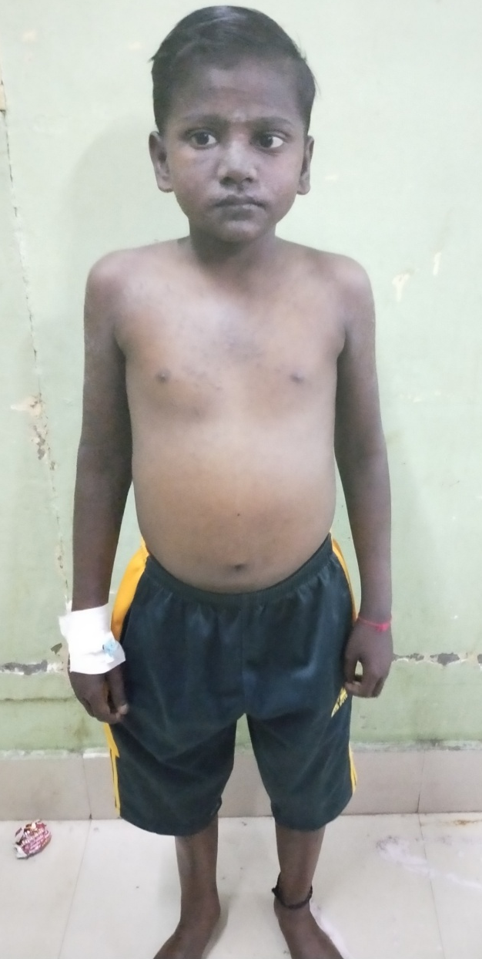
General Examination
O/E
Patient is moderately built
Alopecia +
Pallor +
Maculopapular hyperpigmented rash
Present over face & chest.
No icterus
No cyanosis
No clubbing
Blackish discoloration of nails +
No lymphadenopathy
B/l Pitting pedal Edema +
Height 138 cm
Weight 48 kgs
BMI 25.2

Slide 8
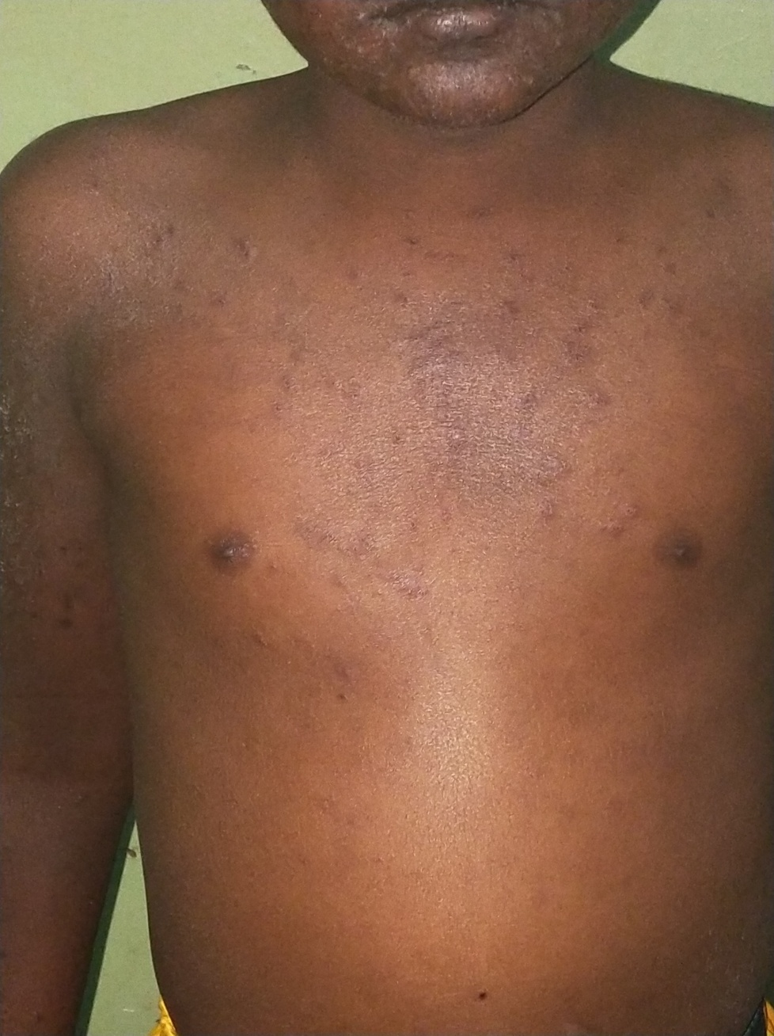

Slide 10
Systemic examination
CVS:S1,S2+,NO MURMUR
RS:B/L Air entry +
No added sounds
P/A:soft,distended
shifting dullness+
CNS:conscious,oriented
Obeys oral commands
NFND

Slide 11
Positive findings
Polyarthritis,H/o GTCs
Alopecia,maculopapular rash,pallor
short stature,Abdominal distension,B/l pitting pedal edema

Slide 12
CBC TC 7,900 DC P79 L 11 E10 | RFT Urea 43Mg % Creatinine 1.0 Mg% RBS:98mg/dl | Serum T.Protein 4.3g/dl Alb:1.2gm/dl Globulin: 3.1gm/dl A/G ratio 0.3
HB 8.3 gms pCV 27% MCV 66.6f/l MCH 20.9 p gm MCHC31.3g/dl RDW 52.4 fl 22.4% | LFT S.Bilirubin total 0.2mg/dl Direct 0.1mg/dl Indirect 0.1mg/dl SGOT 26 U/L SGPT 23U/L ALP 351U /L | Total cholesterol 189mg/dl

Slide 13
ESR
1/2hr. :52mm
1hr. :109mm

Slide 14
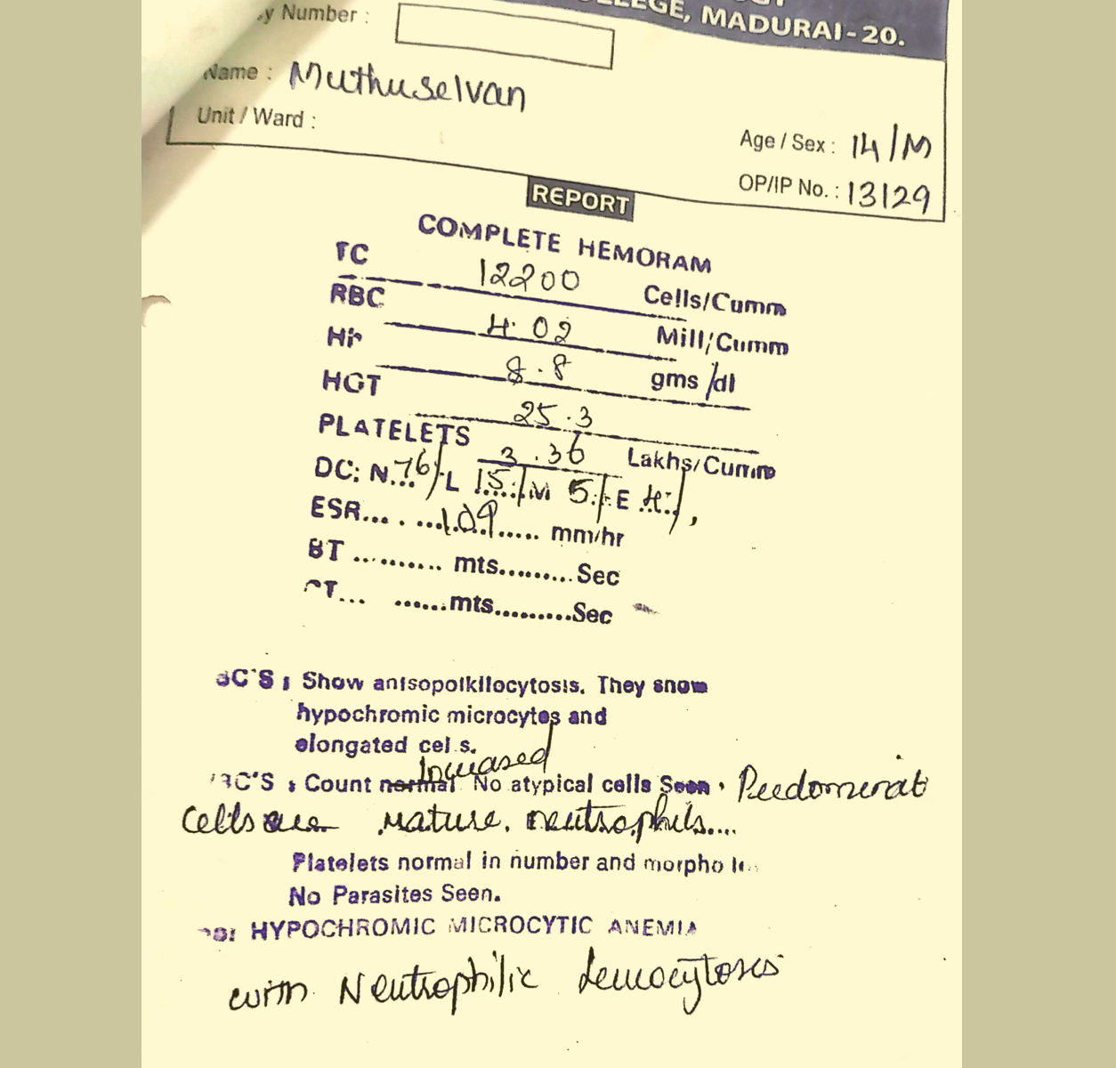

Slide 15
Urine Routine
Color:straw color
Transparency:slightly turbid
Specific gravity:1.020
pH 6.0
Albumin :loaded
Sugar/nil
Bilirubin :nil
Leukocyte/Nitrite/Blood:negative
MICROSCOPY
PC: 3-4/hpf
RBC: nil
Epithelial celltt 01/hpf
No cast/crystals

Slide 16
Repeat urine routine
Albumin:loaded
Urine protein 525
Urine creatinine 33
Spot PCR. 15.909

Slide 17
24 hours urine protein 8.3gms

Slide 18
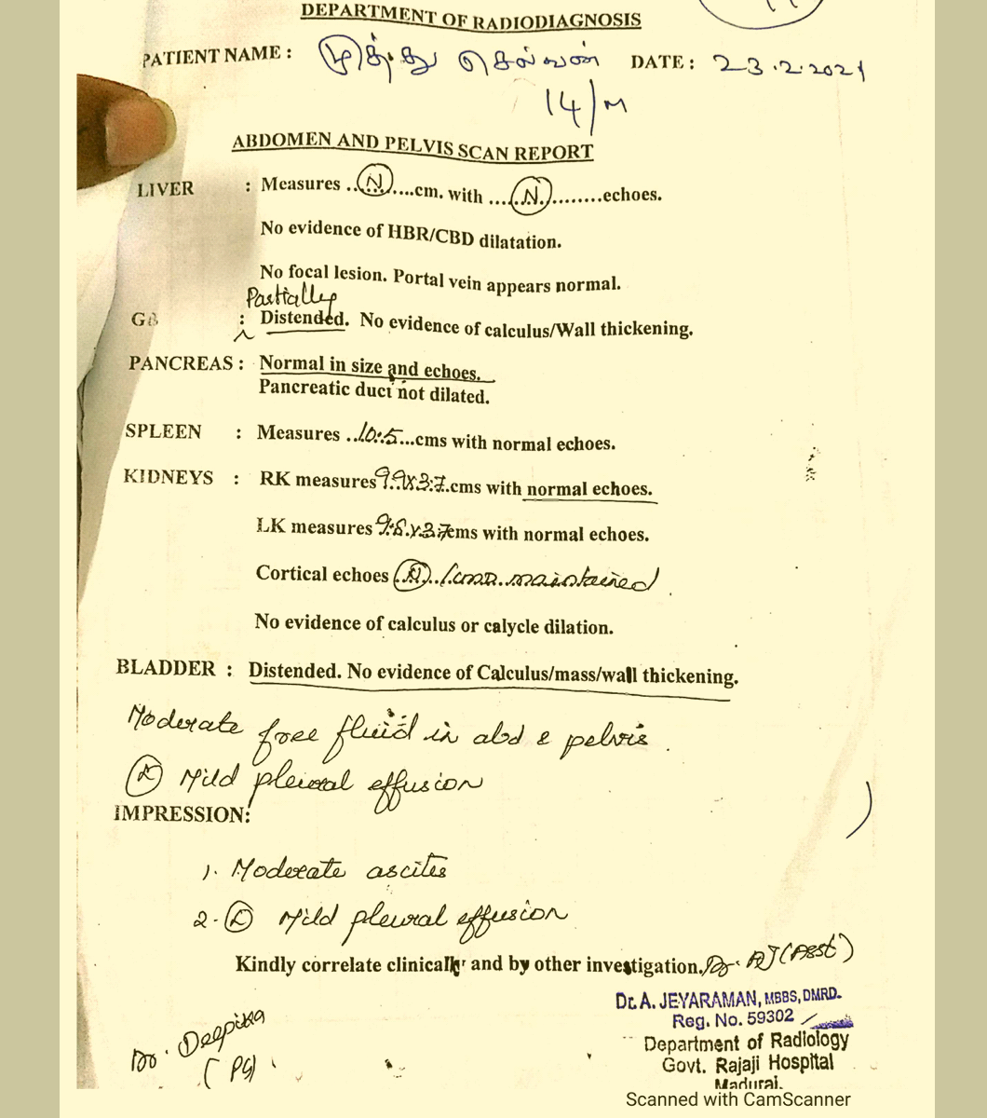

Slide 19
Serum electrolyte
Sr.Na 130mg/dl
Sr.k 5.3mg/dl
Sr.ca;5.5
Corrected calcium =sr.calcium +0.8(normal albumin- serum albumin)
=5.5+0.8(4-1.8)
= 5.5+0.8(2.8)
=5.5 +2.24
corrected calcium=7.7 mg/dl

Slide 20
Sr.phosphorous 7.3mg/dl(3.5 -5.9)
Sr.magnessium 2.1mg/dl(1.7 -2.2mg/dl)

Slide 21
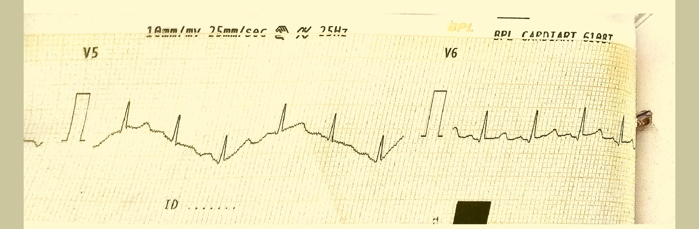
ECG HR 125/min Axis :normal Rhythm:Regular QT interval 280msec QTC 405msec T inversion in v2 v3 v4

Slide 22
NCCT Brain shows Hyperdensity in the B/L basal ganglia and both cerebral hemisphere

Slide 23
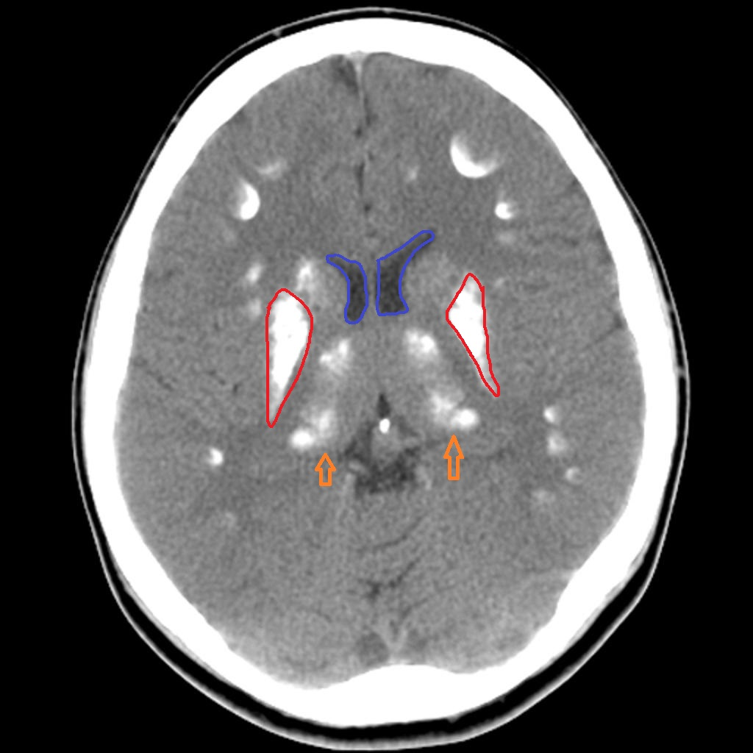

Slide 24
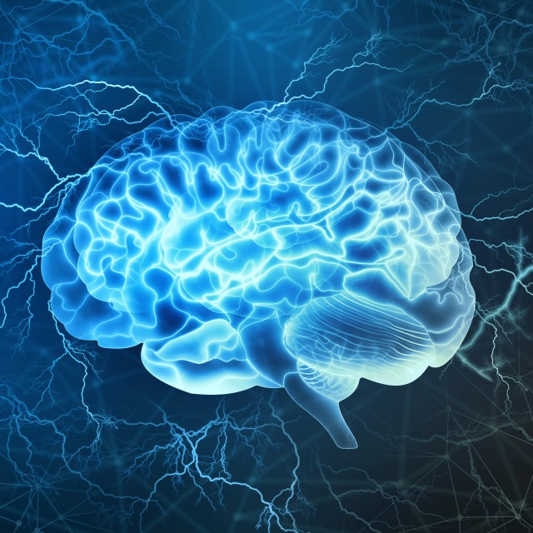
Neuromedicine opinion obtained
Provisional diagnosis
New onset GTCS/Hypocalcemia(to R/o APS)
?Fahr’s disease
Advise given
Correct metabollic parameters
Inj.Levetiracetam 250mg BD
To do MRI brain,sr .PTH

Slide 25
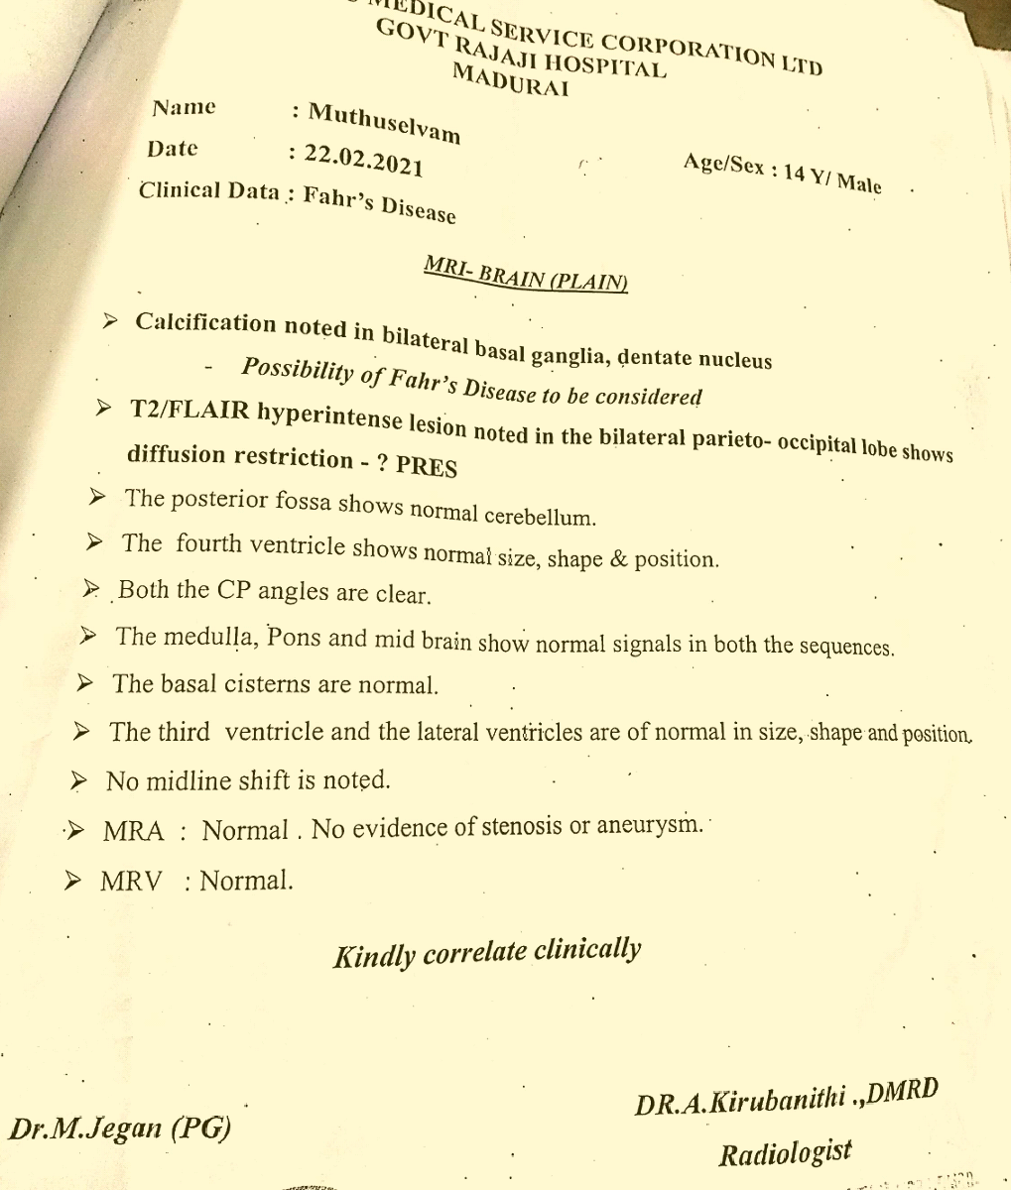

Slide 26
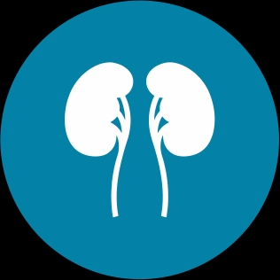
Nephrologist opinion obtained
Impression
Nephroticsyndrome(?FSGS)/Hypoparathyroidism/ ?Calcium sensing receptor mutation
Advise given
Inj.calcium gluconate 10ml iv q8th hrly
I=1.5 litres
To do c3 c4,sr.magnessium,urine Ca++/creatinine ratio

Slide 27
Sr.C3 57.45 mg/dl (80-136)
Sr.C4 13.04 mg/dl(12-43)

Slide 28
Thyroid function test
Sr.TSH 154.01. (0.3-5.5HIU/ml
Free T4:0.316. (0.88 – 1.72mg/dl)
Sr.PTH 1.2pg/ml (14-65pg/ml
Anti TPO antibody >300U/ml (<60)
Sr.cortisol is Normal

Slide 29
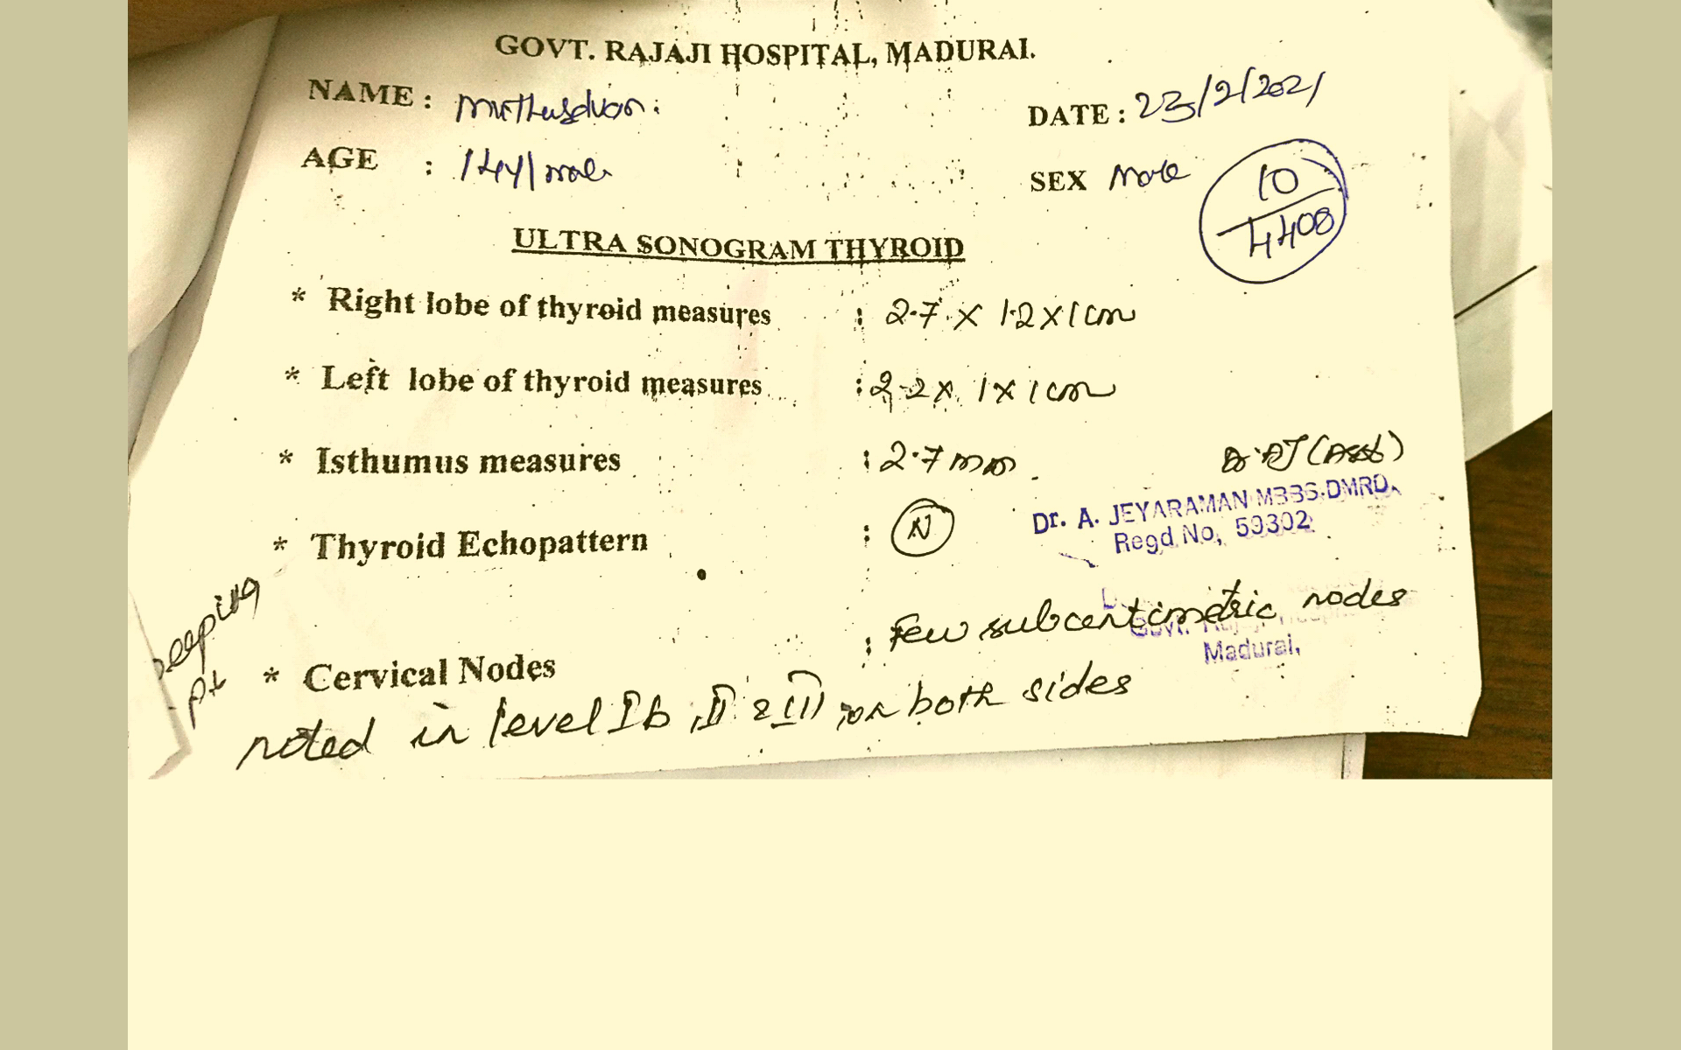

Slide 30
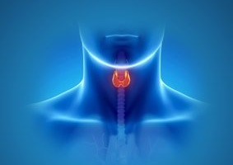
Endocrinologist opinion obtained
Hypothyroidism/Hypoparathyroidism/Nephrotic syndrome/?APS
Advise given
T.Thyroxin 50 mg OD
Calcitriol 0.25mg TDS
Calcium carbonate 500mg TDS
Workup for nephrotic syndrome/Calcium sensing receptor mutation

Slide 31
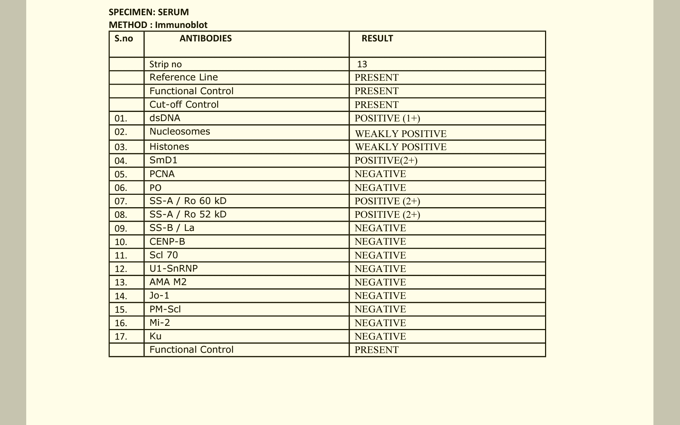
ANA
ANA 17 profile

Slide 33
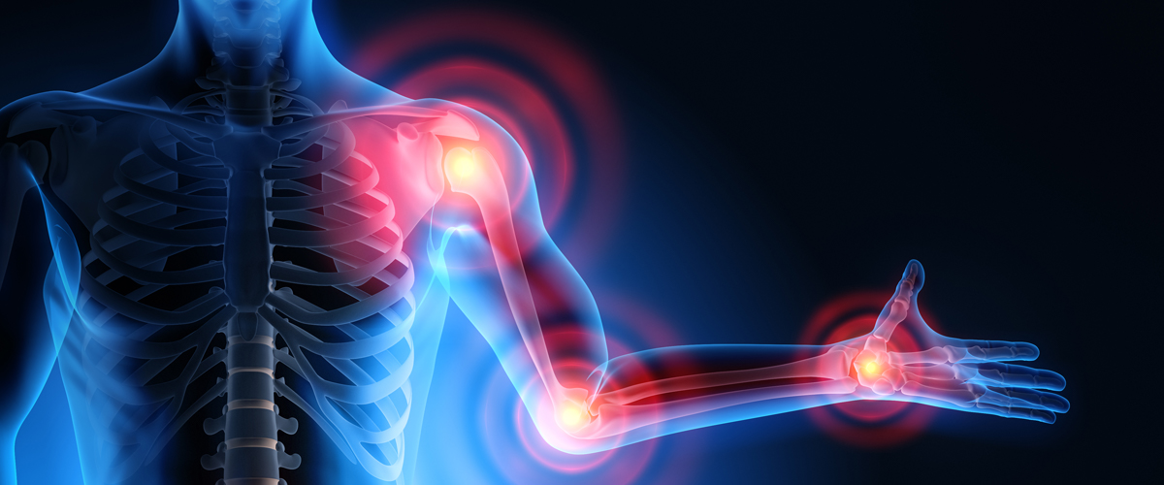
Rheumatology opinion obtained
Impression.
SLE/lupus nephritis/?APS
Advise given
T.Prednisolone 5mg 6 OD
T.Hydroxychloroquine 200mg 1hs
To start T.MMF after renal biopsy

Slide 34
Dermatology opinion obtained
Impression
IBD(papular urticaria)/?Addison’s disease/?Vitamin B12 deficiency

Slide 35
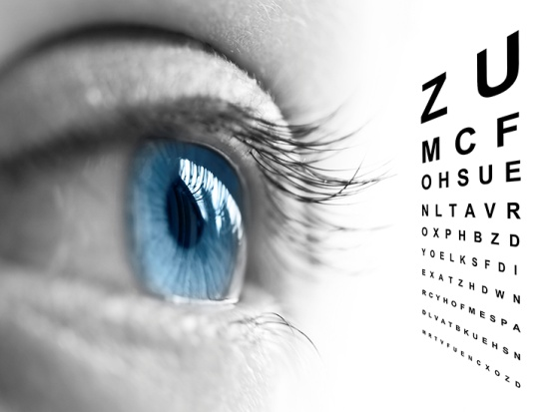
Ophthalmologist opinion obtained
Fundus is normal
No significant ophthalmological abnormalities

Slide 37
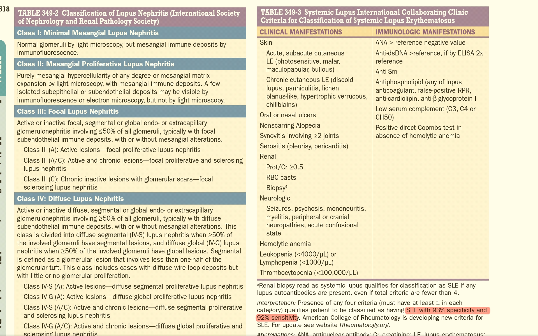

Slide 38
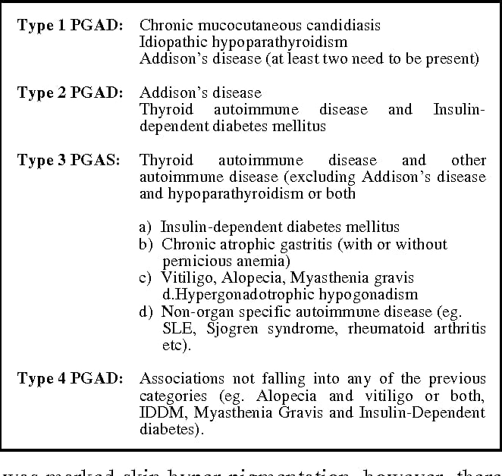

Slide 39
Possible diagnosis
Primary hypothyroidism(Autoimmune thyroiditis)
Hypoparathyroidism(?Autoimmune etiology)
SLE/Lupus Nephritis
APS

Slide 40
Aim of the presentation
SLE in a young MALE child
Associated with multiple endocrine abnormalities

Slide 41
THANK YOU

