Slide 1
CXR AND CT CHEST FOR DISCUSSION

Slide 2
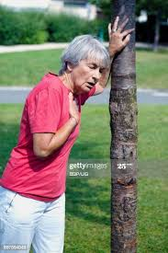
CHIEF COMPLAINTS
A 58 year old male Admitted with c/o
Breathlessness for past 2 weeks.

Slide 3
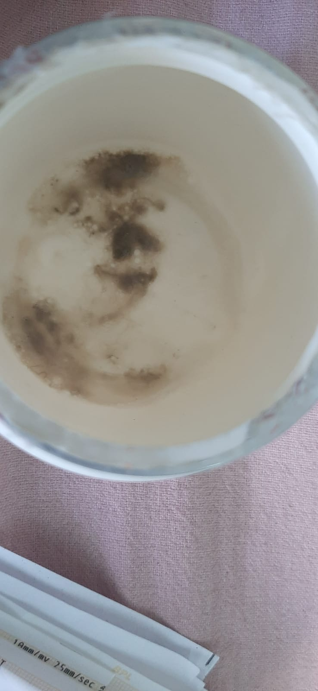
CONT
H/O cough with expectoration present
Patient is typically complaints of grey particulate matter in sputum

Slide 4
GENERAL EXAMINATION
PT IS CONSCIOUS
ORIENTED
AFEBRILE
TACHYPNEIC AT REST
ACCESSORY MUSCLES OF RESPIRATOTY ACTIVITY SEEN
PALLOR PRESENT
NO CYANOSIS/CLUBBING/NO PEDAL EDEMA/NO GENERALIZED LYMPHADENOPATHY

Slide 5
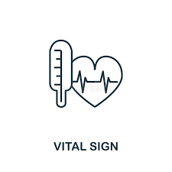
VITALS
BLOOD PRESSURE – 120/80 mmhg
PULSE – 94/min
SPO2 – 92 % IN RA
RR – 38/MIN

Slide 6
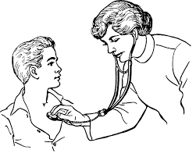
SYSTEMIC EXAMINATION
CVS – S1S2 HEARD , NO MURMUR
RS – B/L AE PLUS
TRACHEA SHIFTED TO RIGHT
AE DECREASED IN RT INFRACLAVICULAR,INFRASCAPULAR,SUPRASCAPULAR AREAS
VOCAL RESONANCE DECREASED OVER ABOVE AREAS
PERCUSSION – IMPAIRED OVER ABOVE AREAS
B/L CREPTS PRESENT IN ALL LUNG FIELDS
B/L POLYPHONIC WHEEZE +
P/A – SOFT , BS+
CNS – B/L PERTL+
MOVES ALL 4 LIMBS
NO FLAPPING TREMORS

Slide 7
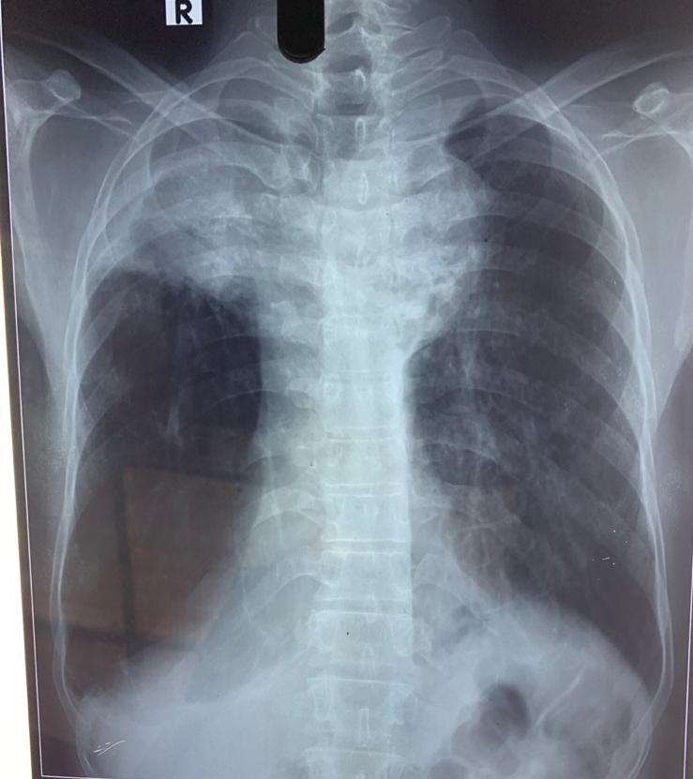

Slide 8
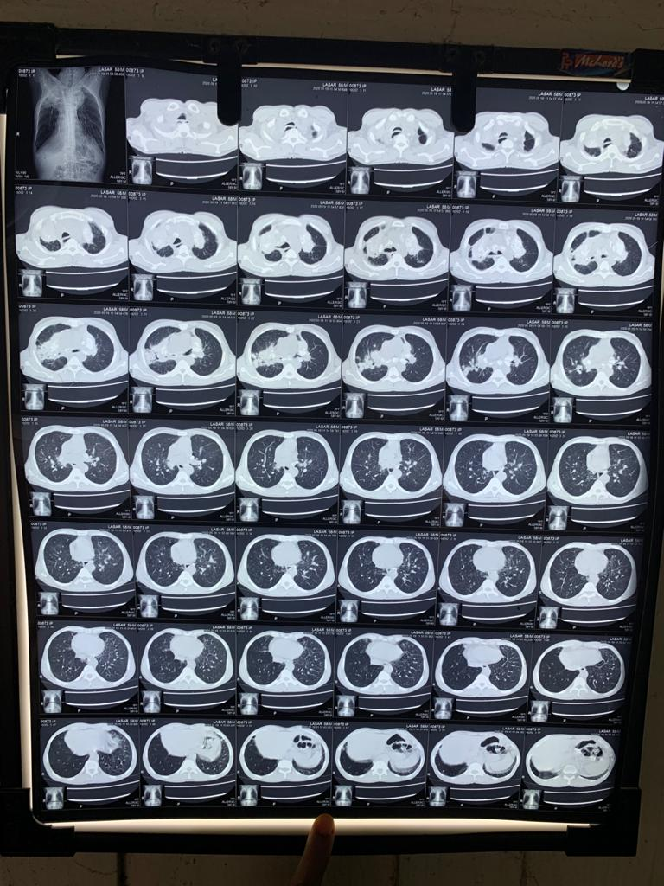

Slide 9
