Slide 1
Blood and blood products
II MEDICAL UNIT
CHIEF: DR. DAVID PRADEEP KUMAR M.D.,
ASSISTANT PROF: DR. PRABHU M.D.,
DR. NASEEMA BANUM.D.,
DR. RAMKUMAR M.D.,
PRESENTOR: DR. VIKRAM KRUSHNAA

Slide 2
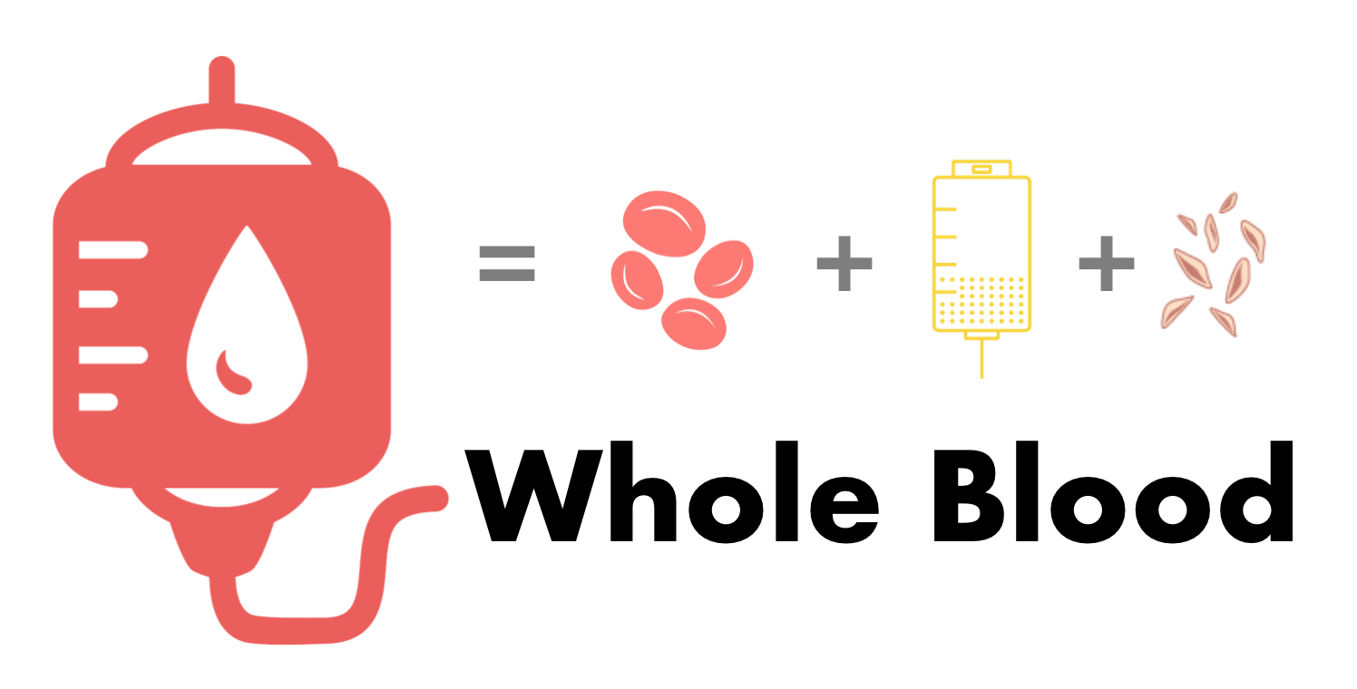
Whole blood:
It has RBC, platelets and
clotting factors at the same time.
It can be used in patients
who require massive transfusion
in severe trauma and DIC.
Advantages:
It has all the components of blood
It is metabolically active than stored blood
Avoids haemodilution

Slide 3
Packed red blood cells:
A single unit of PRBC has 250 to 300 ml and raises HB by 1 g/dl
In children 10 to 15 ml/kg can raise HB by 2 to 3 g/dl
One unit should be transfused within 1 to 2 hours and not more than 4 hours
It is used with micropore filters to filter out aggregates of platelets, fibrin and megakaryocytes
Indications:
Acute blood loss about 30% of blood volume (1500 ml in adults)
Symptomatic anaemia with HB <7 g/dl
Patients with HB < 8 with sepsis or ischemic heart or brain injury.
For patients undergoing major surgeries

Slide 4
Massive transfusion:
Replacing one blood volume or approximately 10 units of PRBC in an adult within a 24 hour period or more than 50% of the patients blood volume within 3 hours
Must be given in the ratio of 1:1:1 of PRBC. FFP and platelets
Indications:
Trauma (severe injuries such as gunshot, solid organ lacerations etc.,)
Obstetric haemorrhage (eg: postpartum hemorrhage)
GI bleed
Surgical complications
Aneurysm rupture
DIC

Slide 5
Complications of Massive blood transfusion:
Coagulopathy due to citrate toxicity/ dilutional coagulopathy
Hypothermia
Hyperkalemia
Hypocalcemia
Iron overload
TRALI and TACO

Slide 6
PLATELETS: stored at 20 -24 degree Celsius for 5 days
Random donor platelets :
8x10*10 platelets with 50 ml plasma
Indicated for patients with bleeding due to critically decreased circulating platelet counts or functionally abnormal platelets
Precautions:
Group specific
Do not refrigerate
Expected raise of 7000 to 10000 for each RDP given
Transfused platelets survive 3 to 5 days unless there is a consumptive process

Slide 7
Single donor platelet:
3.5-4x10*11 platelets with 250 ml plasma
Indications:
To Maintain platelets
>10000/mm*3 in stable non bleeders
>30000/mm*3 in unstable non bleeders
>50000/mm*3 undergoing invasive procedures or active bleeding
>100000/mm*3 for cns trauma
Expected raise of 30000 to 60000 for each SDP
In paediatrics, a dose of 5-10ml/kg of platelets (RDP or SDP) result in 50000 to 100000 increment

Slide 8
FRESH FROZEN PLASMA:
It contains all coagulation factors and fibrinogen
It is stored at 1 to 6 degree Celsius for upto 5 days, when stored below -25 degree C, It can last upto 12 to 24 months
Dose: 15ml/kg
Type AB is the universal donor
Each 200 to 250 ml contains 1 unit/ml of each clotting factor and 2 ml fibrinogen
1 unit of FFP increases coagulation factors by 3% to 5% in a 70 kg adult
Indications:
Administered prior to high risk invasive procedures if PT/INR/aPTT are 1.5x normal or coagulation factor assay <25% normal activity
Coagulation deficiencies in liver failure, drug induced coagulopathy and massive transfusion
Correct coagulation defects for which no factor is available

Slide 9
Precautions:
Thawed plasma should be used within 24 hours when stored in room temperature
Should be group specific
Use blood filters while transfusing
Expected correction:
15ml/kg FFP will increase factor concentration by 25 to 30 %

Slide 10
Cryoprecipitate:
It is derived from FFP by cooling plasma to -4 degree Celsius
Dose : 1 unit/10 kg body weight
One bag contains
80 units factor VII
200 to 300 ml von Willebrand factor
40 to 60 units fibrinogen
Factor XIII
Fibronectin
Precautions:
should be transfused within 6 hours of thawing
Blood filters should be used
Expected correction:
1 unit /10kg BW raises plasma fibrinogen by 50 mg/dl

Slide 11
Indications :
Active bleeding in Von Willebrand disease if desmopressin not effective or if factor VIII concentrate containing von Willebrand factor is not available
Haemophilia A when virally inactivated factor VIII concentrates are not available
Active bleeding in patients with hypo or afibrinogenemia
DIC
Severe liver disease
Abruptio placentae
Amniotic fluid embolism
Massive transfusion

Slide 12
Fibrinogen concentrate:
Derived from pooled human plasma
Dose: 70ml/kg
Prothrombin complex conjugate:
It contains vitamin k dependant clotting factors (II,VII,IX,X) , protein C&S, antithrombin and heparin
Used in warfarin induced bleeding.
Coagulation factor VIIA ( recombinant )
Used to treat hemophilia A and B in Patient who developed inhibitor antibodies to factors VII or IX

Slide 13
Desmopressin
Stimulates the endothelial release of factor VIII and vWF into plasma via V2 receptor where they form a complex with platelets and enhance their ability to aggregate
Indicated in hemophilia A , von Willebrand disease , uremic thrombocytopathy
Dose: 0.3 mcg/kg
Disadvantage:
Tachyphylaxis occurs after repeated doses

Slide 14
PROCESSING TECHIQUES:
Leukoreduction:
Minimize the risk of transmission of infection mainly CMV
Done in immunocompromised patients
Does not prevent transfusion associated graft vs host disease
Filters:
Separate filters for RBC and platelets can be used during collection of sample and during transfusion
Used to prevent febrile non hemolytic transfusion reaction and alloimmunization

Slide 15
Washed RBC:
RBC are washed with saline to remove >98% of plasma proteins , antibodies , leucocytes and electrolytes
Indicated for patients having recurrent severe allergic reactions in-spite of pre-medications, IgA deficient patients
Not as effective as leucoreduction
Gamma irradiation:
It inactivated leucocytes
Prevents GVHD
Indicated in premature infants, patients with malignancy , recipients of allogenic haemotopoietic transfusion, transfusion to blood relatives
Does not reduce infection and febrile non hemolytic transfusion reaction

Slide 16
Adverse reactions of transfusion:
Leukoagglutinin reactions:
Caused by reaction to soluble allergens in donor’s plasma
Occurs within 12 hrs. of transfusion
Signs: fever, chills, urticaria , flushing , pruritus
Treated with antihistamines, acetaminophen and steroids
Prevention: leukoreduction or washed blood products
Febrile non hemolytic transfusion reaction:
Due to reaction between recipient’s antibodies and transfused leucocytes
Signs : fever
Treated with antipyretics and transfuse at slower rate
Prevention: leukoreduction

Slide 17
Anaphylaxis:
Occurs almost always due to allogenic plasma proteins rather than leucocytes
Ig A deficient individuals react to Ig A in transfused units
Signs : flushing , pruritus , laryngo/bronchospasm, hypotension
Treatment:
Stop transfusion
S.C/IV epinephrine, steroids, antihistamines
Iv fluids, vasopressors
Use washed RBC in the future

Slide 18
Sepsis:
Bacterial contamination of blood products (platelets are more prone)
Signs- fever, chills, Hypotension
Treatment: Stop transfusion, Antibiotics according to culture and sensitivity of transfused bag and Vasopressors
Prevention:
Point of care rapid bacterial screening
Blood products infused with psoralen and then exposed to uva light
Infection transmitted:
Screening done for
Hepatitis B surface antigen, hep b core antibody,
antibody to syphilis,
antibodies to HIV 1, HIV 2 and NAT for HIV
Antibody to hepatitis C and NAT for hepatitis C
Antibody to human T-cell lymphotropic/leukemia virus (HTLV)
NAT for West Nile virus
Zika virus by questionnaire
Trypanosoma cruzi

Slide 19
Acute hemolytic transfusion reaction (<24 hr)
Immune mediated – due to cytokines and preformed antibodies (iso-agglutinin mediated)
Risk in 1 in 76,000 transfused units of RBC, death in 1 in 1.8 million transfused units.
Mainly due to ABO causing intravascular hemolysis, renal failure and DIC.
Signs: fever, chills , flushing, chest pain, vomiting, tachycardia and hypotension
Delayed hemolytic transfusion reaction (>24 hrs)
Due to minor antigen mismatch
Due to newly formed antibodies
Causing extravascular hemolysis
Less severe compared to acute hemolytic reaction

Slide 20
Acute hemolytic transfusion reaction | Delayed hemolytic transfusion reaction
<24 hrs | >24 hrs(occurs 5 to 10 days)
Intravascular hemolysis | Mostly extravascular hemolysis
ABO incompatibility | Duffy, Kidd, Kell and C E loci of the Rh system
S/S fever, DIC, AKI, hematuria | S/S jaundice, fever
Rx: stop transfusion, return bag back to blood bank, adequate hydration to prevent AKI Ionotropic supports in shock | Rx: supportive care

Slide 21
Transfusion Related Acute Lung Injury (TRALI):
Diagnosis:
No evidence of lung injury prior to transfusion
Hypoxemia:
Pao2/Fio2 less than 300mmHg
Spo2 less than 90% in room air
Radiograph showing pulmonary edema
No evidence of circulatory overload
Occurs in 1 in 5000 transfused units
Allogenic antibodies in donor plasma react with leucocyte (neutrophil) antigen of recipient including HLA antigens and granulocyte and monocyte specific antigens ( human neutrophil antigen [HNA]-1a, 1b , 2a and 3a)
In 20%, no antigens are identified, raising concern that a bioactive lipids that accumulate while blood product is in storage
No specific treatment
Prevention :
10-20% of female blood donors and 1-5% of male blood donors have anti-leukocyte antibodies in their serum
blood products from male donors are used whenever feasible.

Slide 22
Transfusion Associated Circulatory Overload (TACO):
Diagnosis:
New onset exacerbation of >/= 3 of the following within 6 hrs
Acute respiratory distress( dyspnea, cough)
Elevated BNP, elevated CVP
Evidence of left heart failure, positive fluid balance, radiographic evidence of pulmonary edema
Caused by volume overload
S/S: dyspnea, orthopnea, cough, cyanosis, tachycardia, hypertension
Treatment: back rest, O2 supplementation, diuretics

Slide 23
Transfusion associated graft vs host disease:
Allogenic lymphocytes initiate an alloimmune attack against recipient cells due to discrepant HLA antigens
Occurs mostly in recipients with immune defects, malignant lymphoproliferative disorders, solid tumors on chemotherapy or immunotherapy, immunosuppression(eg: fludarabine)
S/S: fever, rash, diarrhea, hepatitis, lymphadenopathy and severe pancytopenia
No specific treatment
Prevention by gamma irradiated blood products in high risk individuals

Slide 24
Thank you ☺

