Slide 1
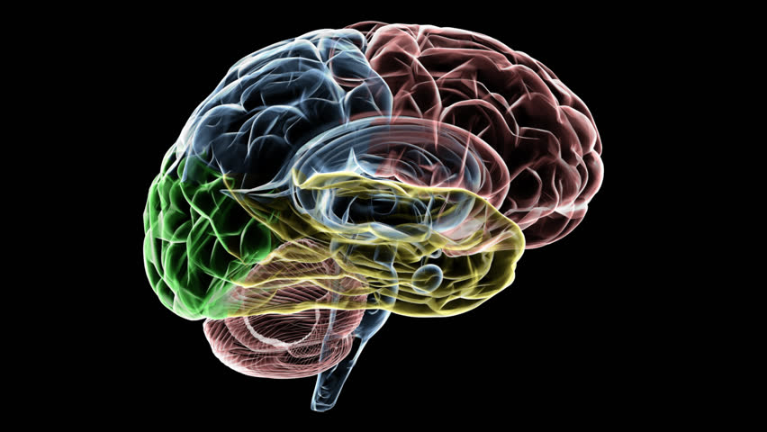
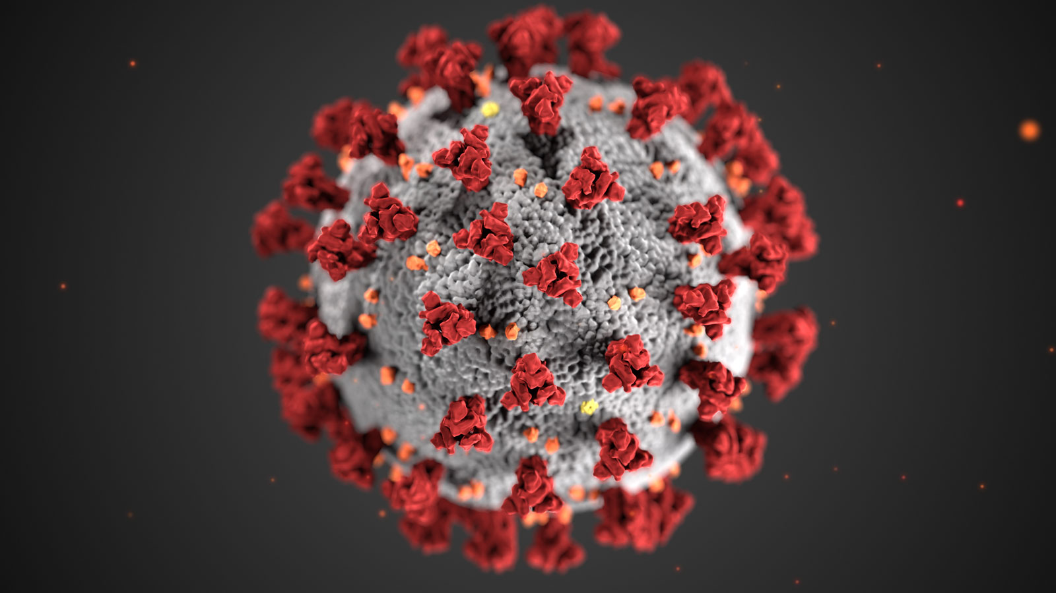
PHYSCON
Chief :HOD Prof Dr.M.Natarajan MD
Asst prof :Dr.P.Shridharan MD
Dr.D.Vasanthakalyani MD DCP
Dr.M.Suresh kumar MD
Presentor: Dr.Sundaravel.S.P

Slide 2
LIFTING THE MASK ON NEUROCOVIDOSIS

Slide 3
Presenting complaints
37 yr old female who is k/c/o of t2dm on irregular treatment went to pvt hospital with the c/o
breathlessness of class 3 NYHA
abdominal distension
facial puffiness
fever on &off ,myalgia for 20 days

Slide 4
Pt was diagnosed to have T2DM/Hypothyroidism/ARDS/LVF/MODS /AKI
pt was treated with higher antibiotics, ventilator support for 7 days and inotropic support and pt improved symptomatically and was doing well and pt was ambulent for 1 day after weaning off from ventilator
During course in hospital after 20 days of admission pt underwent a tragic phase

Slide 5
then arises the tragic phase !!!!!!!!!!!!!!

Slide 6
Pt suddenly developed flaccid type of weakness of lowerlimb PROXIMAL= DISTAL & upper limb DISTAL > PROXIMAL with numbness & parasthesia of lower limb hence pt was referred to grh for further management
other history:
no h/o bowel and bladder disturbance
no h/o chest pain and palpitation
no h/o skin rash or joint pain
no h/o altered sensorium or seizure
no h/o spinal trauma
no h/o recent vaccination,no h/o loose stools

Slide 7
No h/o disturbance in smell perceptiom
no h/o blurring of vision / difficulty in seeing distant & near object
no h/o diplopia
no h/o deviation of angle of mouth
no h/o regurgitation of food
no h/o hearing disturbance
no h/o deviation of tongue & difficulty in shrugging the shoulders

Slide 8
obstetrics history
PARA 2 LIVE 2
NO Abortion or still birth
past history:
k/c/o t2dm on irregular treatment
recently diagnosed hypothyroidism ON TAB THYROXINE 150ug

Slide 9
on examination
pallor + ,left axillary lymphnode palpable 2* 2 cm in dimention
b/l claw hands +, b/l pitting pedal edema ,facial puffiness +
vitals :
PR - 95/ min
BP - 140/60 mm hg
spo2-99% @ room air
systemic examintion
cvs: s1s2 + ,no murmur
RS:NVBS,B/L basal crepts +
p/a : soft ,bs+,distended ,striae - present

Slide 10
higher mental function : all normal
motor system:b/l claw hand +
Tone: hypotonia seen in b/l lower limb
power :
joints | Right | left
shoulder | 4/5 | 4/5
elbow | 4/5 | 4/5
MCP | 4/5 | 4/5
PIP | 3/5 | 3/5
Hip | 5/5 | 3/5
knee | 2/5 | 2/5
ankle | 2/5 | 2/5

Slide 11
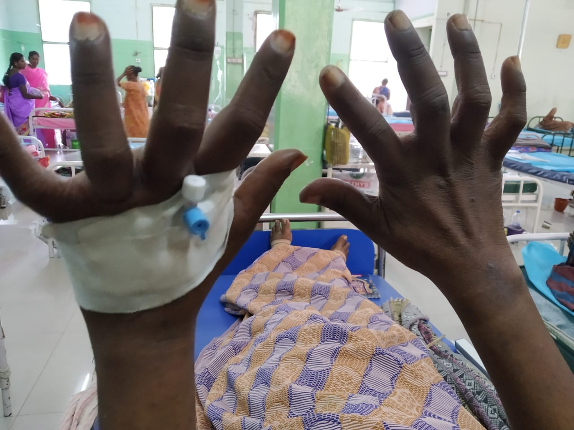

Slide 12
DTR : Areflexia
Plantar: b/l no response
B/L Claw hands +, no nerve thickening
no fasciculation

Slide 13
cranial nerve examination
1 st - normal sense of smell bilaterally
2nd - acuity of vision is normal on both side
3,4,6 - pupillary reflex - reactive equally on both side ,all six cardinal movenment of eye is present on both side
5 th - sensation over the face normal on both side corneal reflex - normal B/L
7 th - able to shut the eye tightly,able to hold air in the mouth
8 th - AC > BC ,No nystagmus
9,10 - normal gag reflex, normal position of uvula
11 th - able to shrugg the shoulders
12 th - able to protrude tongue ,no deviation

Slide 14
Sensory system : dysaesthesia & parasthesia below knee joint in b/l lower limb
Cerebellar coordination test – normal
Spine n cranium – normal &no spinal tenderness

Slide 15
neurology opinion
advised T3,T4 ,TSH Level
CSF analysis
MRI Dorsolumbar spine with screening of other spine
inj B6,B1,B12 IM OD
CAP pregabalin hs
inj dexa 8 mg bd
review
inj methyl prednisilone 1gm in 100 ml ns OD * 5 days
NCS study on later dates
PROVISIONAL DIAGNOSIS : ACUTE QUADRIPARESIS / ?GBS

Slide 16
working diagnosis
T2DM/S-HTN/HYPOTHYROIDISM/VH FEVER/ MYOCARDITIS/WITH ?AIDP ( post viral) ?
CRITICAL ILLNESS NEUROPATHY / MYOPATHY Diabetic radiculoneuropathy

Slide 18
Outside investigation showed
Ct chest and abdomen :1] b/l pleural &pericardial effusion
2] anasarca ,ascites ,both the kidneys are enlarged and edematous
3]b/l supraclavicular, left side infraclavicular ,both axillary lymphnode ,retroperitoneal lymphadenopathy
Ct brain : normal
lft value : total bilirubin : 2.2 direct : 0.9 /ID :1.3 /SGOT : 65/ SGPT : 71 / ALP :315
RFT VALUE : UREA : 99 , CREATININE : 3.7

Slide 19
investigation @ grh
Cbc: initially showed leukocytosis , anemia and thrombocytopenia after transfusion of 1 packed cell and 5 platelet counts improved ahter 2 weeks
rbc -2.13 million
mcv - 93.7 fl
mch -27.7 pg
mchc - 29.5g/dl
sd - 78.6 fl / cv 26.5
Tc | 17,100 | 11600 | 8600 | 5500 | 7700 | 6700 | 7600
Dc | 61/33/6 | 60/34/6 | 65/26/9 | 47/44/9 | 58/33/9 | 60/39/1 | 56/36/8
Hb | 3.9 | 4.0 | 5.6 | 6.3 | 6.3 | 8.8 | 9.4
Pcv | 13.9 | 14 | 20 | 22 | 21 | 30 | 33
Plt | 9000 | 9300 | 11000 | 9000 | 13000 | 96000 | 1.70 l
esr | 60 mm

Slide 20
Lft : all repeated values were normal
Rft : initially it was [94/1.9] and gradually retured to normal value
Serum protein : AG reversal + (2.0/3.1)
Urine routine : albuminuria + ,spot pcr value -64 (1800/28)
Serum electrolyte is normal from the day of admission

Slide 21
urine and blood culture : no organism
viral markers and vctc : negative
IgM Dengue : negative
scrub typus igm : negative
CRP - Positive
CPK value - 22 mcg/l
RF - negative
Ferritin level : increased [210]
CSF Analysis : protein : 138 mg%
sugar: 50 mg%
cells : no cells

Slide 22
investigation
peripheral smear : hypochromic microcytic anemia
with reticount 1.5%
bone marrow aspiration: normocellular marrow
hypochromic microcytic anemia with reactive rise in
megakaryopoeisis
TFT: euthyroid state
pt inr : 12.2[0.90]
ecg : LAD & PPRW from v1 to v5

Slide 23
imaging
Usg abdomen : moderate ascites
Echo outside on 25 /12 showed global hypokinesia with EF of 31 % ,RA RV dilated with severe rv dysfn ,grade 2 lv diastolic dysfunction
Repeated echo in grh on 22/1 showed no RWMA ,EF is 55 %
Mri cervical spine with screening of other spine showed disc bulge with anterior thecal sac indentation noted in I4 &l5 without compression and otherwise normal report

Slide 25
New ray of hope

Slide 26
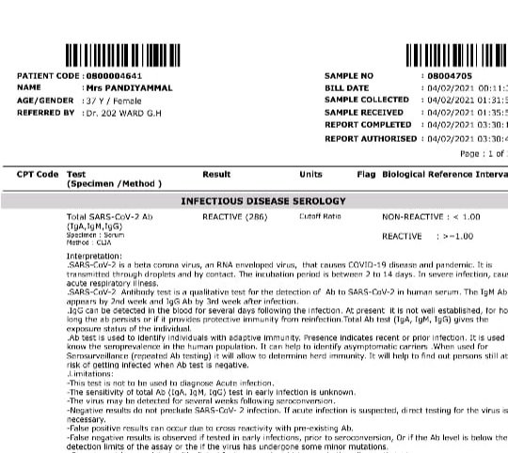

Slide 27
Finally
Diagnosis : hypothyroidism /t2dm /shtn/AIDP ( ?POST COVID SEQUELE)/

Slide 28
treatment given
tab.ATORVASTAIN 10 mg 0-0-2
inj Methyl prednisilone for 5 days
inj astymin iv infusion OD
tab . thyroxine 150 ug 1-0-0
inj enoxaparin 0.4 cc s/c OD
inj .Insulin
tab . alprazolam
tab.folic acid and amitriptyline
physiotherapy

Slide 29
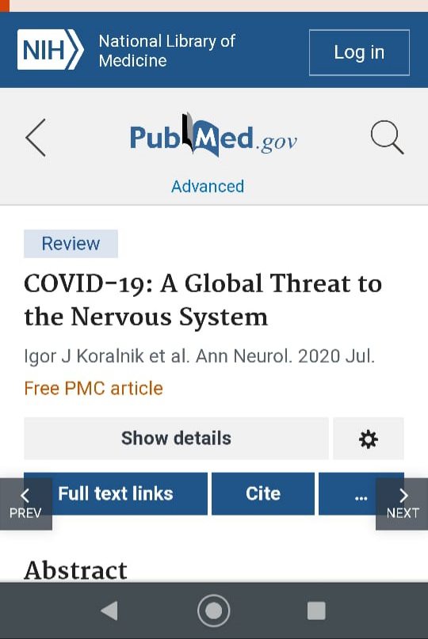
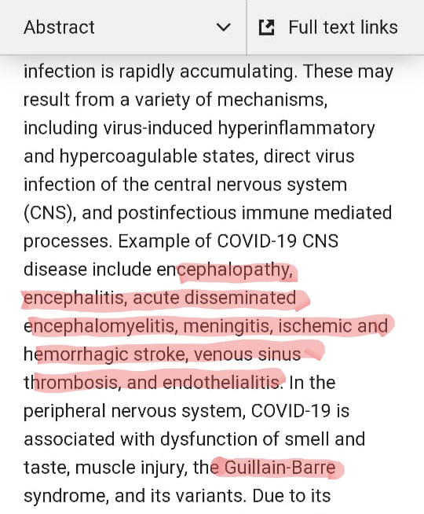
AIM OF THIS PRESENTATION
AIDP IS ONE OF THE NEUROLOGICAL COMPLICATION OF POST COVID SEQUELE (this may be due to direct virus infection or post infectious immune mediated process)

Slide 30
thus in this covid era one should always think covid as the one of the cause of AIDP

Slide 31
thank u all

