Slide 2
VII MEDICAL UNIT
CHIEF: PROF.DR.K.SENTHIL.MD
ASSOCIATE PROF: DR.K.MURALIDHARAN MD
ASST PROF: DR V.MANIKANDAN MD
DR C. RAMANAN MD
DR.SARAVANA MADAV MD

Slide 3
A 21 yr female MISS.MUNEESWARI admitted with
chief complaints - difficulty in breathing past 1 week
Bilateral leg swelling for past 1week
menorrhagia ~7 days
gum bleeding for 2 days

Slide 4
HISTORY OF PRESENTING ILLNESS:
patient had history of multiple episode of gum bleeding since 6 month of age and history of menorrhagia since menarche for which she had multiple blood transfusion for anemia . Now she presented with difficulty in breathing (initially class II - III)
H/o bilateral leg swelling for 1 week
H/o menorrhagia, (changing pads~10/day)
H/o gum bleeding since 2 days
No H/o chest pain

Slide 5
No H/o cough with expectoration /fever
No H/o abdomen pain / abdomen distension
No H/o Decreased urine output
No H/o yellowish discoloration of urine
No H/o hematuria
No H/o loose stools
No H/o malena

Slide 6
PAST HISTORY:
Not a known DM, SHTN,Epilepsy, PTB,HIV, CKD, Heart disease.
MENSTURAL HISTORY:
Attained menarche at 14 yrs of age
irregular cycle , increased flow ,> 7 days approx
Associated with clots

Slide 7
FAMILY HISTORY :
Parents – fourth degree consanguineous marriage
h/o sudden death of third child (cause-unknown)
Younger sister- bleeding disorder
TREATMENT HISTORY:
patient had similar complaints in the past (since 6 month of age) Treated with repeated blood transfusion with PRBC, Whole blood and platelets (approx once in year till she attained menarche , after menarche frequent transfusion done)

Slide 8
PERSONAL HISTORY:
-Mixed diet
-No history of any drug intake(OTC,Herbal)
-No history of exposure to Radiation
-No history of exposure to toxins,chemicals
-studied upto VIII std

Slide 9
O/E
Patient Conscious , oriented
Pallor + , B/L Pedal edema + , Not icteric
No Cyanosis , No clubbing , No lymphadenopathy
Head to foot examination – Normal
Oral cavity – normal
Fundus - normal
CVS – S1S2 +,LVS3 +, JVP RISED, HEMIC MURMUR +
RS – NVBS ,NO ADDED SOUND
P/A – SOFT, NO HSM
CNS -NFND

Slide 10
INVESTIGATIONS
Bleeding time > 15 mins
PFA 200
Collagen/ADP : > 162 (Reference range68-142)
collagen/epinephrine > 193(89-167)
Clot retraction – good
Prothrombin time -12.3 (10.0-12.5)
Activated partial thromoplastin time – 37.4(24.7-37.5)
Thrombin time 15.1(14.0-18.0)

Slide 11
CONT
Factor assay
factor VIII :C : 176.2% (Ref 50-150%)
factor IX:C : 100.2% (Ref 50-150%)
factor XI :C : 52.5% (Ref 50-150%)
factor XII:C : 28.7% (Ref 50-150%)
fibrinogen : 242 mg/dl (150-450mg/dl)

Slide 12
CONT
RISTOCETIN COFACTOR ASSAY (VWF:Rco) : 93.7 % (Ref 50-175)
PLATELET AGGREGOMETRY –platelet rich plasma was hemolysed. hence aggregometry studies could not be interpreted. Small response seen with normal dose ristocetin and absent response with other agonist
FLOW CYTOMETRY
platelet gated FSC VS SSC using 42b as platelet marker shows absent expression of CD 41

Slide 13
DATE | 28/6/2021 | 29/6/2021 | 30/6/2021 | 1.07.2021
TRANSFUSION | PACKED CELL 1 UNIT | PACKED CELL 1 UNIT | PACKED CELL 1 UNIT | PACKED CELL 1 UNIT
TOTAL COUNT | 3400 | 2900 | 4200 | 5500
HEMOGLOBIN | 1.2 | 2.2 | 3.4 | 4.5 | ???????
PLATELET | 1.2L | 69000 | 60000 | 62000 | PT – 14 APTT – 32
TOTAL BILIRUBIN | 1.9 | 3.0 | 3.5 | 5.1 | LDH 1330
INDIRECT | 1.5 | 2.2 | 2.8 | 4.1 | URINE + HEMOSIDERIN
DIRECT | .0.4 | 0.8 | 0.7 | 1.0 | DCT NEGTIVE
UREA/CR | 23/0.7 | 20/0.7 | 26/0.8 | 26/0.8 | ICT POSITIVE

Slide 14
MCV-71fl
MCHC-32%
MCH-23pg
RDW-37%
Serum Iron-47 mcg/dl
Transferrin saturation-12.30%
TIBC-382mcg/dl

Slide 15
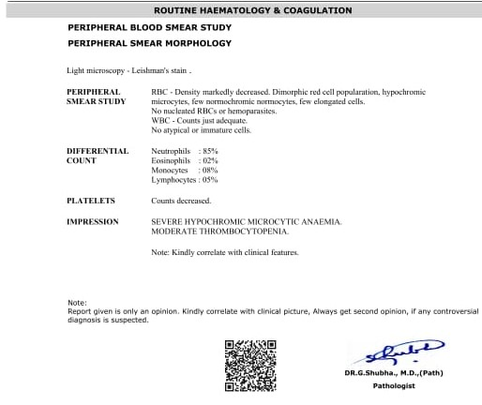
PERIPHERAL SMEAR (DAY 1 )

Slide 16
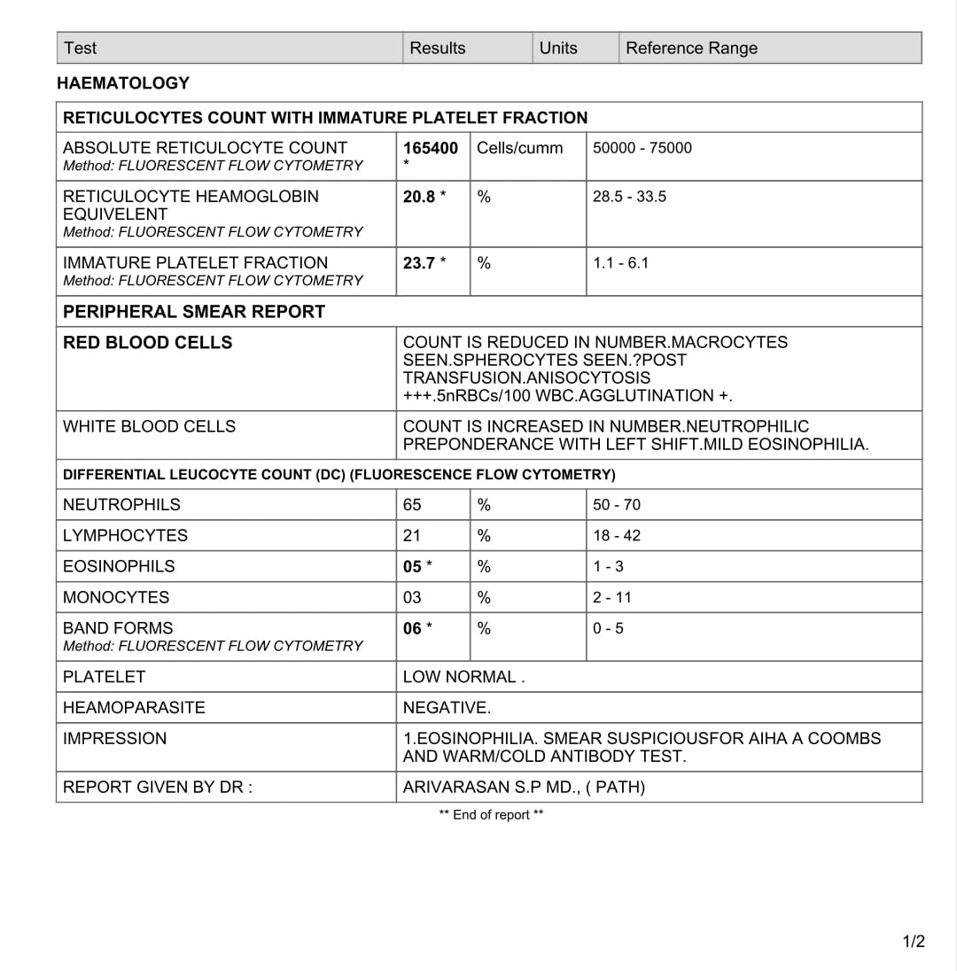
PERIPHERAL SMEAR (DAY 5 )

Slide 17
USG ABDOMEN – MILD SPLENOMEGALY
PORTAL AND HEPATIC VEIN DOPPLER- NORMAL
ECHO – NORMAL STUDY
CRP – NEGATIVE
Ig M DENGUE – NEGATIVE
MP/MF- NEGATIVE
COVID SWAB NEGATIVE

Slide 18
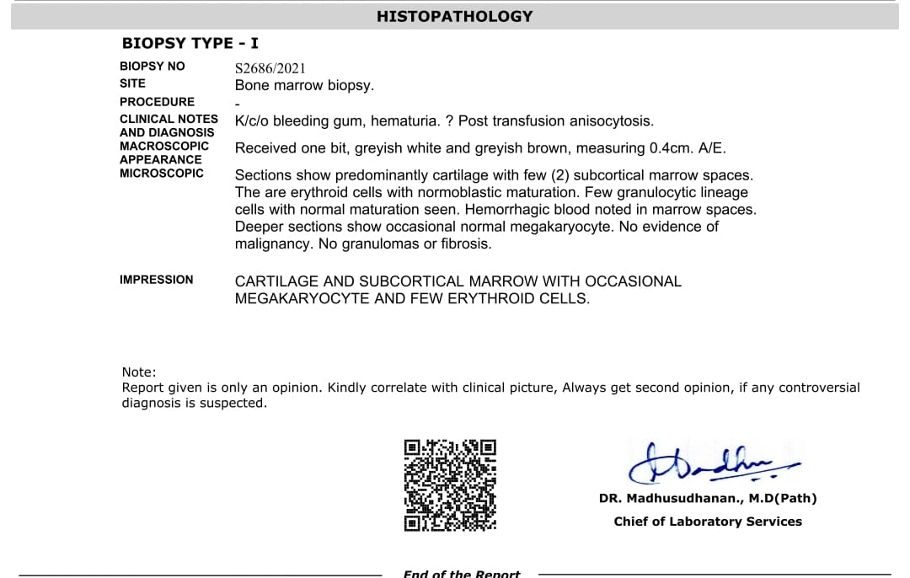
BONE MARROW BIOPSY

Slide 19
PROVISIONAL DIAGNOSIS
GLANZMANN THROMBASTHENIA WITH PANCYTOPENIA/HEMOLYTIC ANEMIA F/E

Slide 20
ANALYSIS
RESTROSPECTIVE STUDY OF PREVIOUS RECORDS FOUND TO HAVE ELEVATED INDIRECT BILIRUBIN FOLLOWING THE BLOOD TRANSFUSION

Slide 21
DATE | 19 JUN 2019 | 25 JUN 2019 | ON DISCHARGE
TRANSFUSION | 2 PRBC 4 PLATELETS 2 WHOLE BLOOD
TOTAL COUNT | 4700 | 8400 | 5600
HEMOGLOBIN | 1.9 | 3.4 | 4.8
PLATELETS | 1.53L | 71000 | 64000
TOTAL BILIRUBIN | 0.7 | 8.5 | 1.9
INDIRECT | 0.3 | 7.9 | 0.7
DIRECT | 0.4 | 0.6 | 1.2

Slide 22
DATE | 15.12.2020 | 17.12.2020 | 21.12.2020
TRANSFUSION | PRBC - 4 UNIT
TOTAL COUNT | 6400 | 4000 | 9500
HEMOGLOBIN | 7.3 | 4.4 | 3.4
PLATELETS | 2.60L | 99000 | 1.29L
TOTAL BILIRUBIN | 0.9 | 1.8 | 3.3
INDIRECT | 0.5 | 1.0 | 2.9
DIRECT | 0.4 | 0.8 | 0.4

Slide 23
EXTENDED CROSS MATCHING ANALYSIS
Anti E antibody reactive

Slide 24
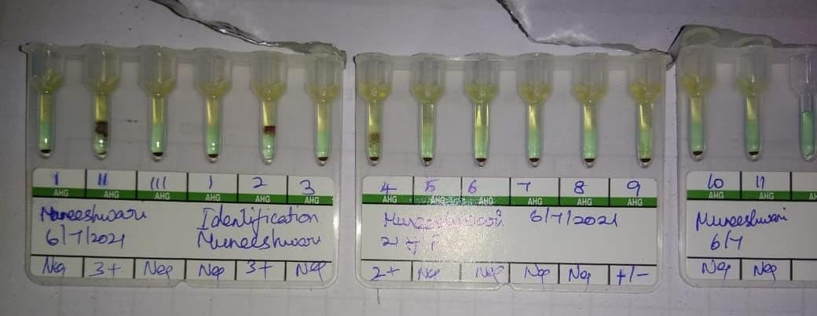

Slide 25
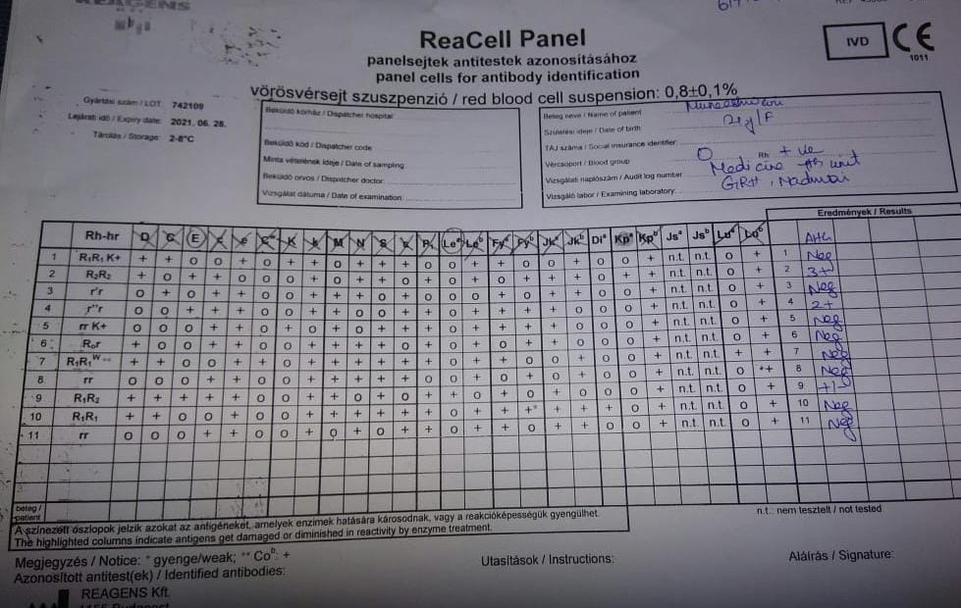

Slide 26
FINAL DIAGNOSIS
GLANZMANN THROMBASTHENIA
ALLOIMMUNE HEMOLYTIC TRANSFUSION REACTION (ANTI E AGAINST RBC )
? ANTI HLA MEDIATED PLATELET DESTRUCTION .

Slide 27
TREATMENT
EXTENDED CROSS MATCHED BLOOD TRANSFUSION
HLA MATCHED PLATELET TRANSFUSION

Slide 28
POST TREATMENT

Slide 29
DATE | 05/07 | 06/07 | 07/07
TRANSFUSION
TOTAL COUNT | 7900 | 5600 | 5400
HEMOGLOBIN | 4.2 | 4.7 | 4.6
PLATELET | 60000 | 65000 | 80000
TOTAL BILIRUBIN | 2.0 | 2.2 | 1.0
IN DIRECT | 1.0 | 1.0 | 0.4
DIRECT | 1.0 | 1.2 | 0.6
UREA | 30 | 19 | 17
CREATININE | 0.8 | 0.5 | 0.9

Slide 30
AIM OF PRESENTATION
APPROACH TO THE BLEEDING DISORDER
TO SENSITIZE ABOUT THE TRANSFUSION RELATED COMPLICATIONS

Slide 31
THANK YOU

