Slide 1
A case of massive hepatomegaly
First medical unit
CHIEF: PROF.DR.M.NATARAJAN M.D.,
ASSISTANT PROFESSORS: DR.V.PALANI KUMARAN.M.D.,D.Diab.,
DR.D.VASANTHA KALYANI.M.D.,D.C.P.,
DR.M.SURESH KUMAR M.D.,
PRESENTATION BY V. THARUN VARMAN

Slide 2
CHIEF COMPLAINTS
A 56 year old female patient Mrs Revathi came with chief complaints of
Abdominal distention for past 5 months
Pruritis for 3 months

Slide 3
HISTORY OF PRESENTING ILLNESS
The Patient was apparently normal 5months back then she started developing abdominal distention Insidious onset ,progressive In nature and attained present size
H/o reduced intake of food +
H/o loss of weight +
H/o Easy fatiguability +

Slide 4
History of presenting illness
No H/o fever
No h/o night sweats
No h/o Cough with expectoration
No h/o Bone pain

Slide 5
Past history
K/c/o Hypothyroidism since 15 years of age On T.THYROXIN 100 microgram OD
K/c/o Diabetes mellitus for past 9 years on Tab. Metformin 500 mg BD
H/O drug intake for PRIMARY COMPLEX for six months in 12 yrs of age(records NA)
Not a known case of SHTN/BA/THYROID/SEIZURE DISORDER

Slide 6
Family history
No relevant family history

Slide 7
Personal history
Consumes mixed diet
Regular bowel and bladder habits
Normal sleep pattern
No adverse social habits

Slide 8
Menstrual history
Attained menopause at 36 years of age

Slide 9
General examination
Conscious
oriented
afebrile
No Pallor
No cyanosis
no clubbing
no icterus
no generalized lymphadenopathy

Slide 10
B/L mild pitting pedal edema
No goiter
No purpuric spots/rashes
No sternal tenderness
No leg ulcers

Slide 11
Vitals
BP- 110/70 mmhg
PR- 98/min
Spo2- 98% In room air

Slide 12
SYSTEMIC EXAMINATION
CVS -s1,s2 heard ,no murmur
RS -B/L air entry present +, no added sounds
Abdomen- asymetrically Distended, divarication of recti +
Liver palpable 20cm below RCM
Traubes space obliterated
CNS- No focal neurological deficit

Slide 13
Investigations
CBC | 22/05/2023 | 23/05/2023
TC | 4600 | 6100
HB | 16.8 | 12.4
HCT | 51.8 | 37.2
PLT | 2.28lakhs | 2.95lakhs
MCV(fl) | 80.6 | 79.5
MCH (pg) | 26.1 | 26.5
MCHC(g%) | 32.4 | 33.3
RBC | 6.43 | 4.68

Slide 14
FASTING LIPID PROFILE
serum cholesterol-148mg/dl
Serum Tgl-107mg/dl
Serum hdl-27mg/dl
FBS -88mg/dl
PPBS -230mg/dl
RFT
Sr. urea- 16
Sr. creat-0.8
HbA1c- 7.9%

Slide 15
LFT: T.Bil-1.3. Serum protien-Total.pro 7.7
DIRECT-0.7. Albumin-3.0
INDIRECT- 0.6. Globulin-3.7
SGOT-12.
SGPT-11. Serum uric acid-5.9mg%
ALP-185
PT-15.8
INR-1.2

Slide 16
VCTC-Non reactive
Viral markers: HBsAg-negative.
Hcv-negative

Slide 17
Urine bile salt/bile pigment- Negative

Slide 18
Peripheral smear
RBC's-Normochromic normocytes
WBC’s-count is normal,no atypical cells seen.
N-65%,L-30%,E-2%,M-1%
Platelets normal in number and morphology
No hemoparasites
reactive lymphocytes +

Slide 19
Usg abdomen and pelvis
Hepatomegaly-m/s 23 cm,altered echoes,surface regular,
portal vein diameter m/s -1.2cm,Normal hepatocellular flow
Velocity-13cm/s
Gall bladder-over Distended,1.3mm calculi at neck of gb,wall thickened m/s-5mm
Mild splenomegaly m/s 11cm

Slide 20
Moderate ascites
B/L Adnexa free
Peripheral collateral noted around intrahepatic portal branches,few peripancreatic collateral+
IMP-PARENCHYMAL LIVER DISEASE,CALCULUS CHOLECYSTITIS

Slide 21
Ascitic Fluid ANALYSIS
Sugar-176
protein-3007 mg
LDH-177
cholestrol-73
Cell count: polymorph-8
Lymphocytes-4

Slide 22
ASCITiC FLUID ANALYSIS
ADA – 13 U/L
CYTOLOGY- NEGATIVE FOR MALIGNANT CELLS

Slide 23
CECT abdomen
Hepatomegaly-23.6cm with altered attenuated
Splenomegaly(11.5cm)- multiple focal lesions,S/o reticuloendothelial infiltrative disorder
Features of Cholelithiasis
Thin rim of ascites

Slide 24
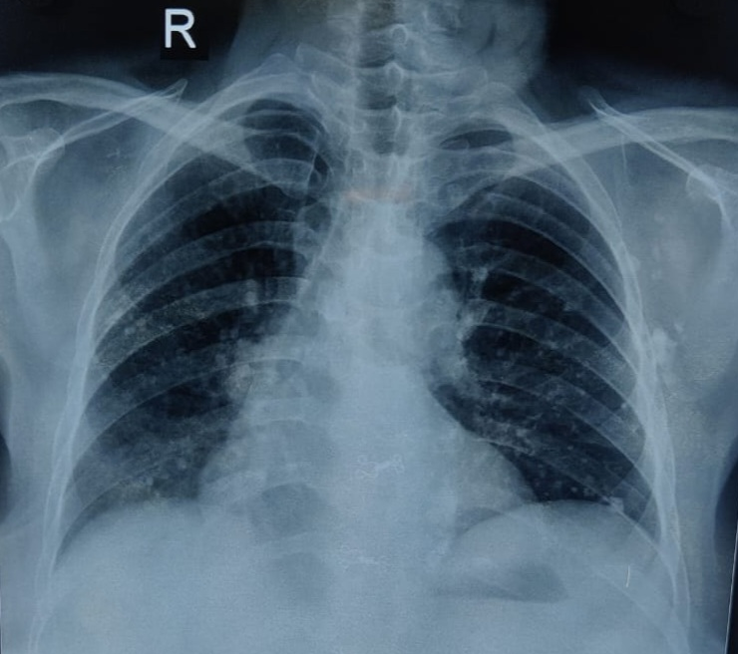
CHEST XRAY

Slide 25
CT chest
Lung-parenchymal calcification noted in b/l lung fields,
predominantly- Rt Upperlobe+Lt upperlobe+lower lobe
Lymphadenopathy- few subcentric mediastinum lymphnodes noted.
Few calcified mediastinal and axillary lymphnodes noted
p/o calcified granuloma

Slide 26
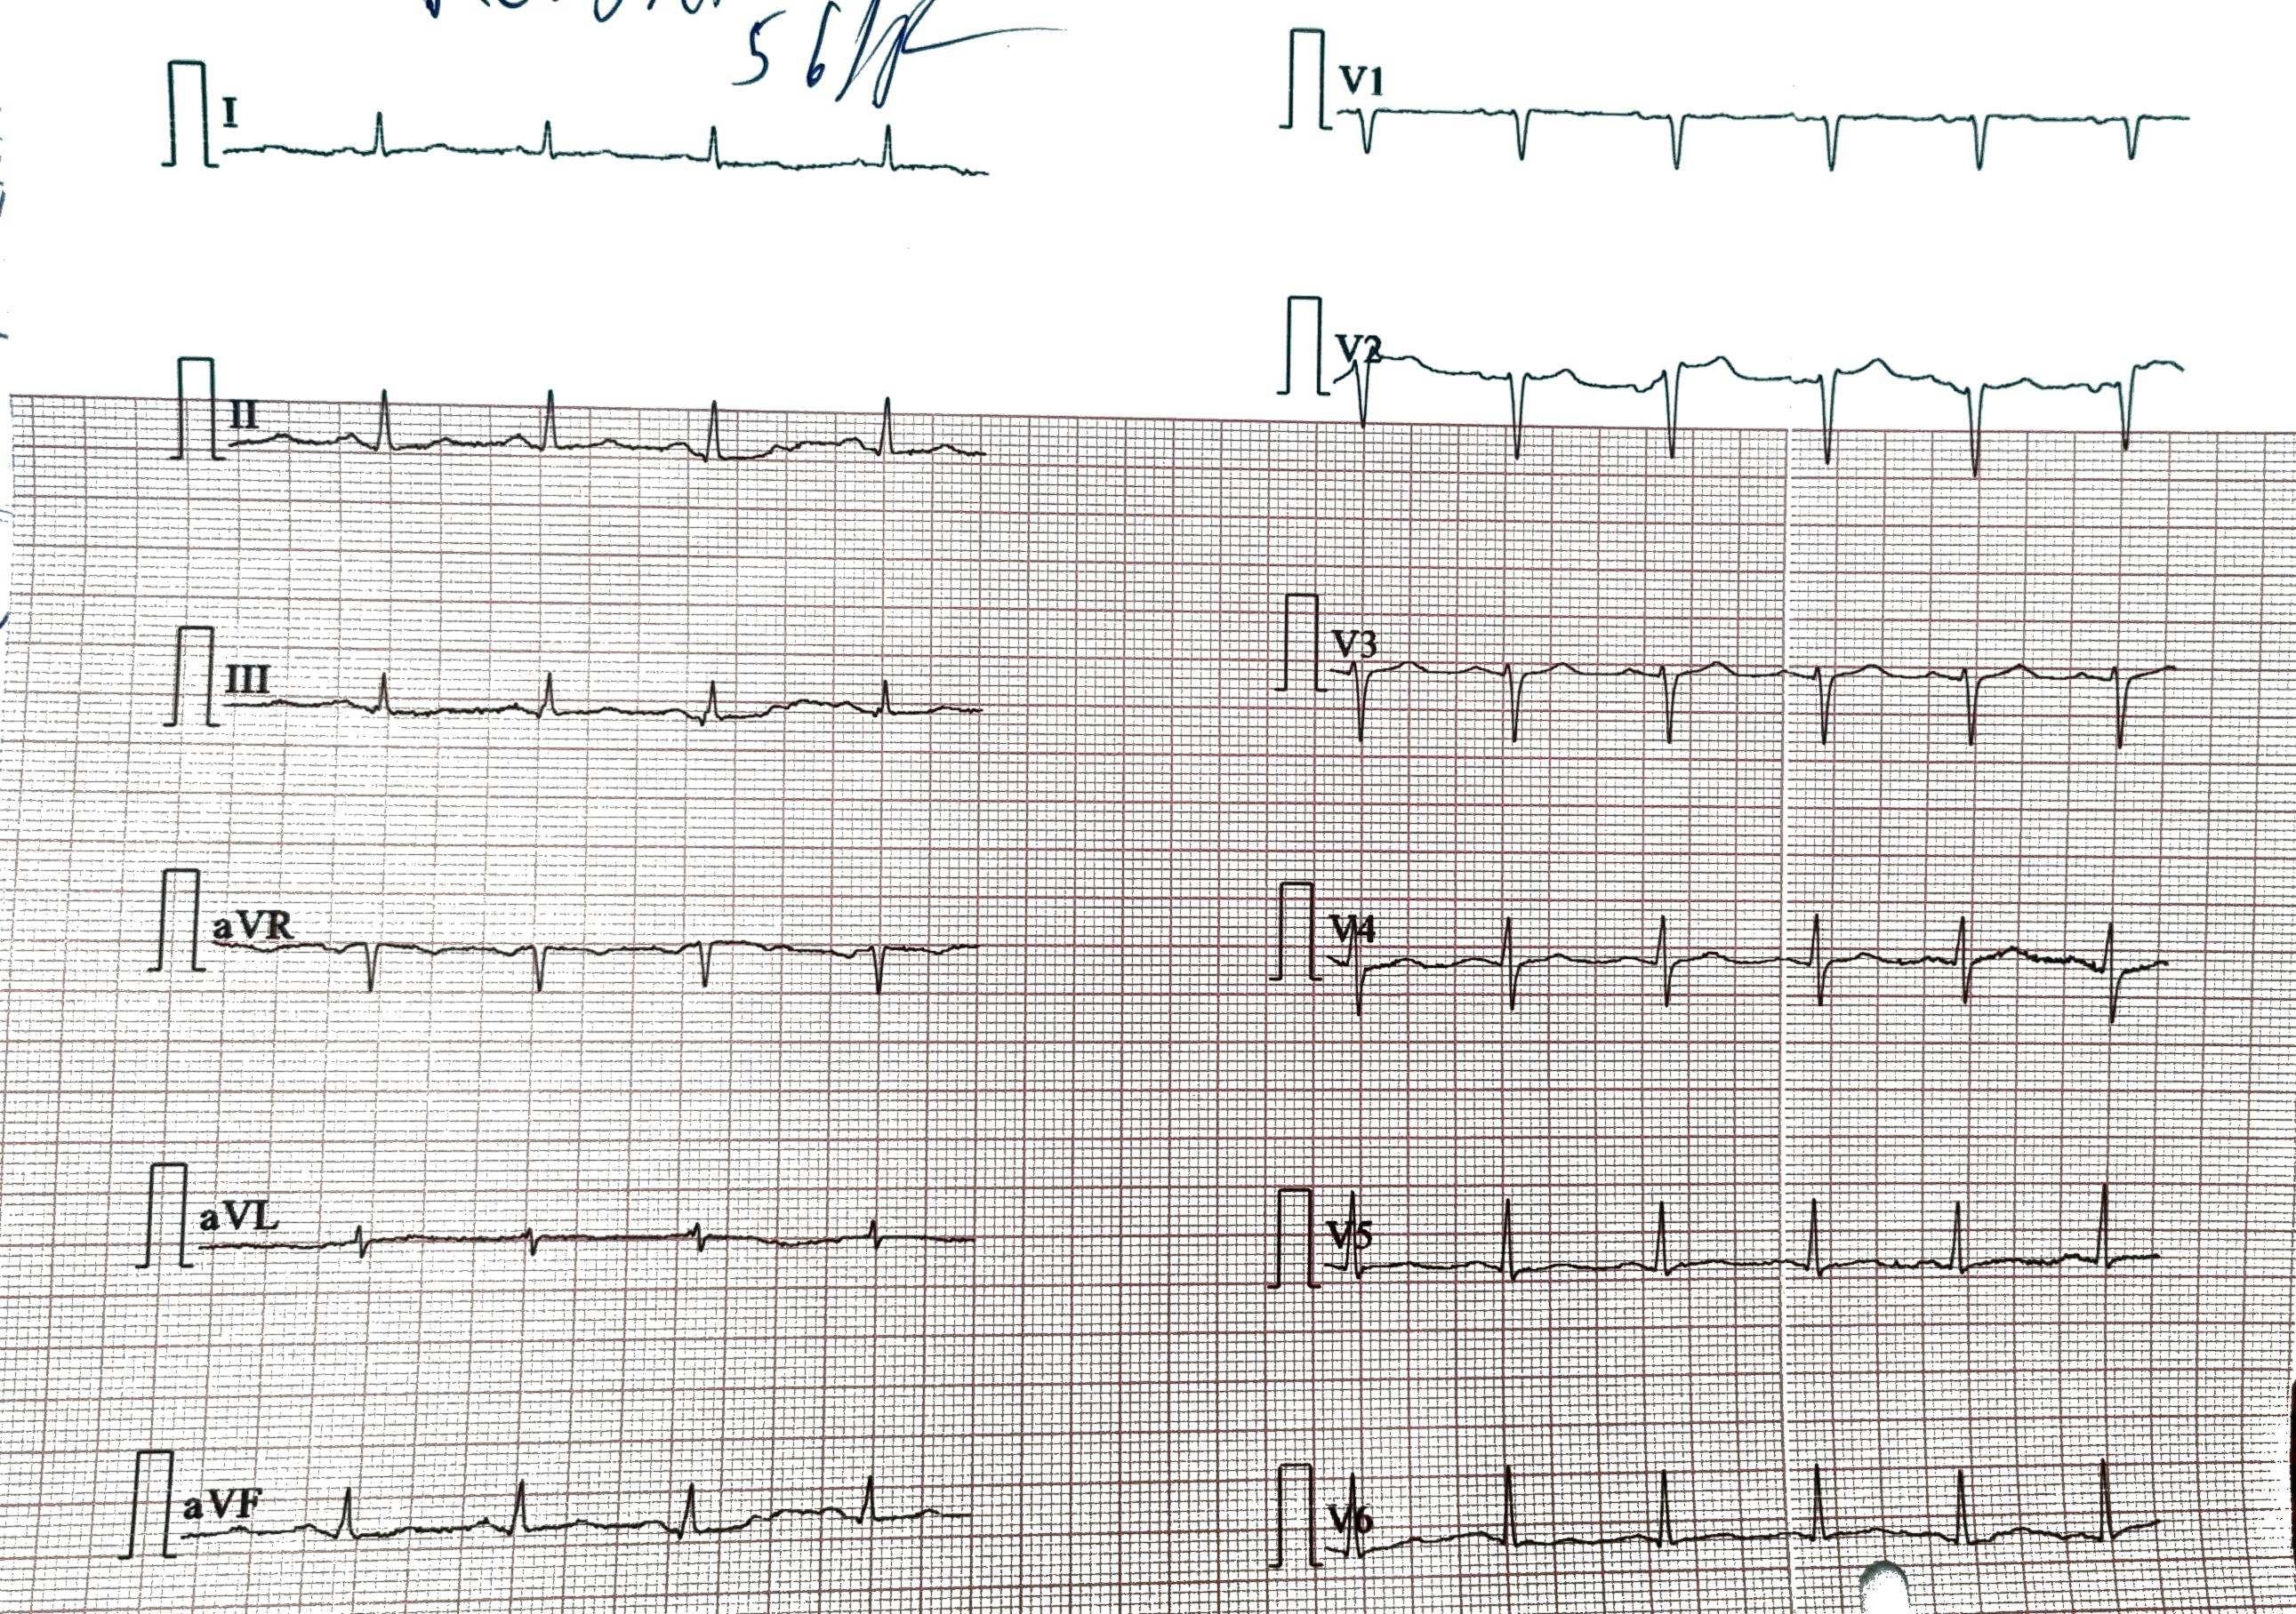

Slide 27
Echocardiography
LVIDD-4.5 cm
LVIDS-3.0 cm
LVEF -65%
Concentric LVH +
AR mild

Slide 28
PFT
Suggestive of restrictive pattern

Slide 29
Ophthalmology opinion
No evidence of uveitis at present

Slide 30
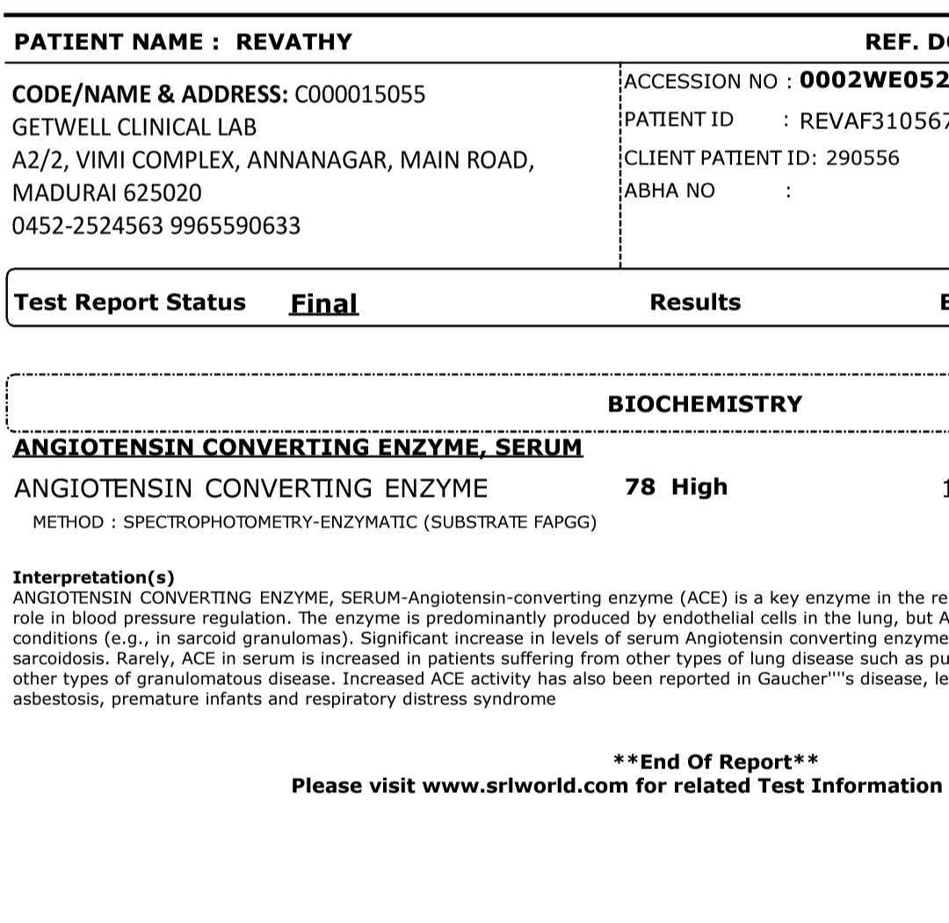
SR CALCIUM- 10.9 mg/dl
SR CORRECTED CALCIUM- 11.7 mg/dl

Slide 31
MANTOUX – 0 MM INDURATION
LIVER BIOPSY GENE XPERT – MTB NOT DETECTED

Slide 32
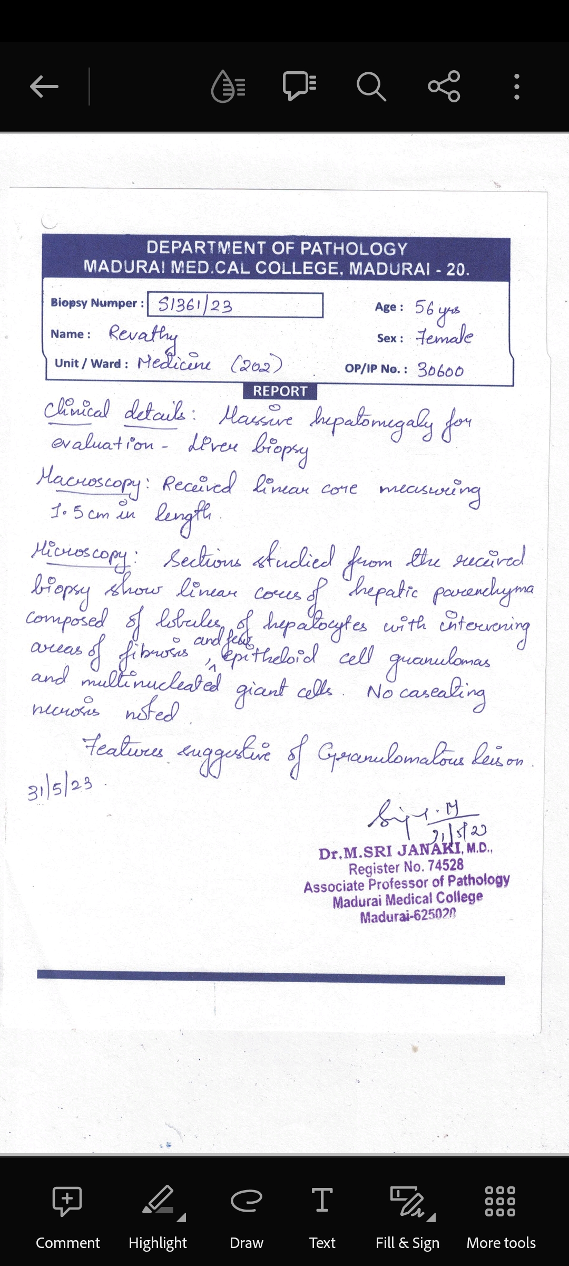
Histopath examination of liver trucut biopsy specimen

Slide 33
Points favoring sarcoidosis
Massive hepatomegaly-non tender
Anicteric cholestasis
Elevated Sr.Ca
Elevated ACE Levels
Non caseating granulomas

Slide 34
Final diagnosis- granulomatous hepatitis due to sarcoidosis

Slide 35
Treatment GIVEN
T.THYROXINE 150 MICROGRAM
T.METFORMIN 500MG BD
T. PREDNISOLONE 30 MG 0D
TAB. HCQ 200 MG HS

Slide 36
THANK YOU !!!

