Slide 1

STUFFED SWOLLEN SPLEEN
BY
IV UNIT
CHIEF: DR.DHARMARAJ.,MD
ASSOCIATE PROFESSOR:
DR.TAMILVANNAN M.D,
ASSISTANT PROFESSOR
DR.PRABHU.,MD
DR.ARUL PRAKASH.,MD
DR.BALASELVI.,MD
PRESENTOR :DR MAHALAKSHMI

Slide 2
A 25 years old female presented with complaints of
abdominal distension & abdominal pain for past 4 months

Slide 3
HOPI
h/o Abdominal distension -insidious, gradually progressive, not uniformly distended, localised to left upper quadrant
associated with abdominal pain localised in left upper quadrant,which is intermittent dull aching , dragging in nature.
h/o easy fatiguability,early satiety present
No h/o loss of weight
No h/o fever

Slide 4
On examination,
patient
moderately built and nourished
pallor+
no generalised lymphadenpathy
VITALS
BP:110/70mmHg
PR: 112/min
SpO2:98%
TEMP:98.5’F

Slide 5
S/E
CVS: S1, S2 +,
RS: BAE+ ,
P/A: soft, bs+
tenderness +in the left hypochondrium
spleen palpable 12cm below the LCM extended upto umbilicus( GRADE 4)
no visible pulsation, no splenic rub/Bruit
CNS: NFND

Slide 6
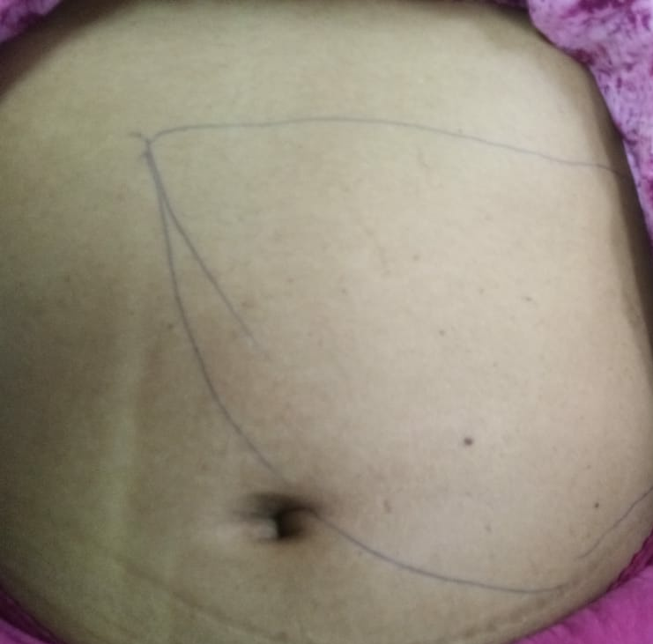

Slide 7
A CASE OF MASSIVE TENDER SPLEENOMEGALY

Slide 8
INVESTIGATION:
CBC
TC | 49400
DC | 56/30/14
HB | 7.8
PCV | 23
PLATELET | 4,95
UREA | 16
CREATININE | 0,7
RBS | 176
LFT
T.BILIRUBIN | 0.3
I.D BILIRUBIN | 0.1
D.BILIRUBIN | 0.2
SGOT | 51
SGPT | 36
ALP | 227

Slide 9
CHG WITH PERIPHERAL SMEAR
RBCs show hypochromic microcytes, normochromic normocytes, polychromatophils and nucleated. RBCs=4/100 WBCs
WBC count is increased with atypical blastoid cells 15%
Platelet count increased
Reticulocyte count – 1.5%

Slide 10
Usg abdomen
Spleen measures 28 cms with normal echoes.
Splenic vein normal.
Rk normal: LK displaced slightly anteriorly by the enlarged spleen.
Liver normal
Right ovary hemorrhagic cyst 2.2*2.7cm with internal septation and no vascularity

Slide 11
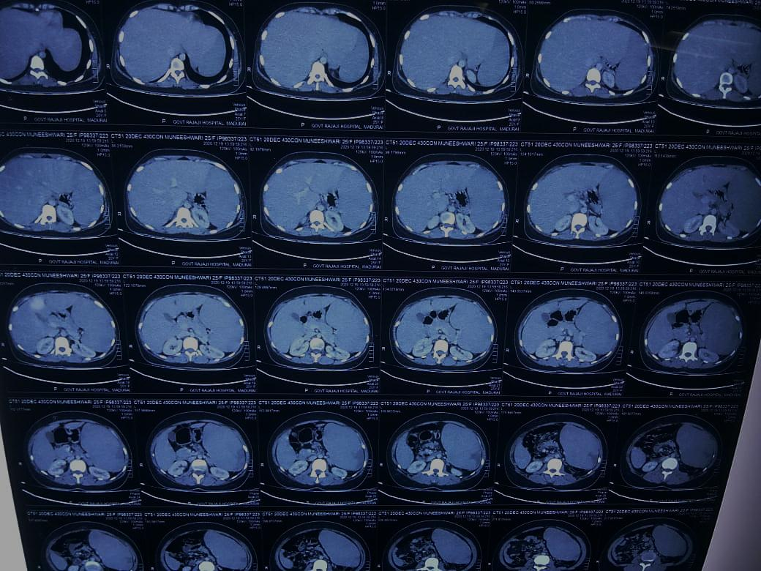
CT abdomen

Slide 12
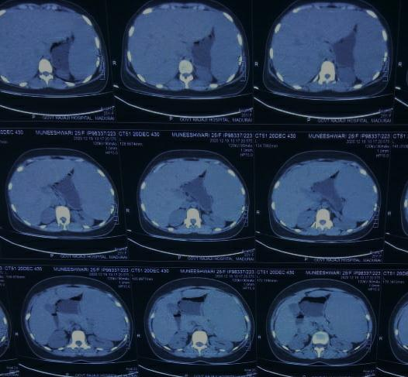

Slide 13
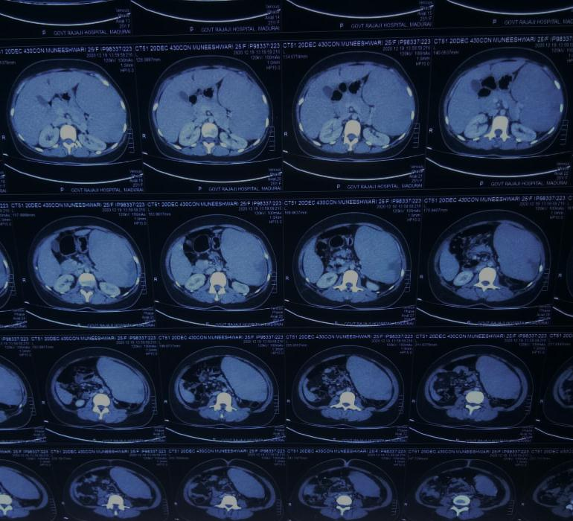

Slide 14
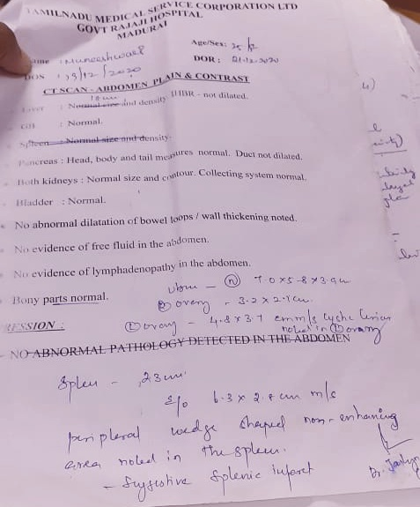

Slide 15
Spleen measures 23 cm
Evidence of peripheral wedge shape Non enhancing area noted in spleen suggestive of infarct

Slide 16
ECHO
LVEF – 60%
Normal study

Slide 17
ATYPICAL BLASTOID CELLS | 15%
MYELOCYTES | 12%
METAMYELOCYTES | 04%
BAND FORMS | 04%
NEUTROPHILS | 48%
EOSINOPHILS | 04%
MONOCYTES | 01%
LYMPHOCYTES | 12%

Slide 18
DIFFERNTIAL DIAGNOSIS FOR SPLENIC INFARCT WITH SPLENOMEGALY
Splenic artery occlusion – due to emboli
Splenic vein thrombosis
Leukemia / Lymphoma / Myelofibrosis
Vasculitis
Malaria

Slide 19
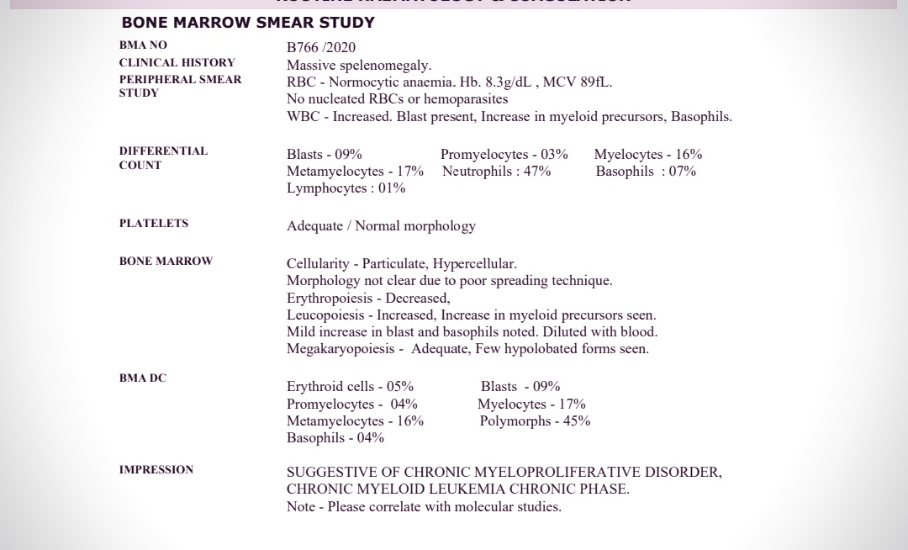

Slide 20
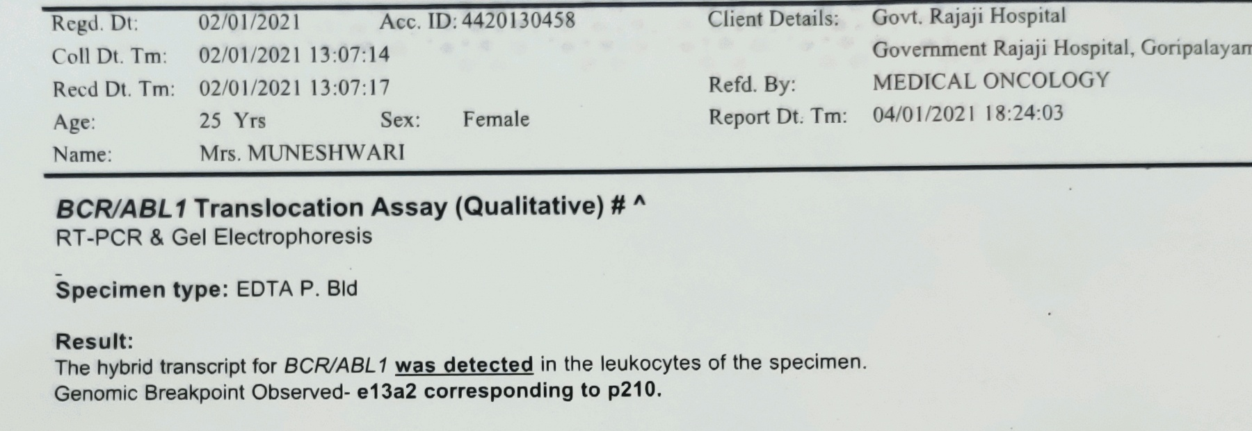
BCR-ABL1 RTPCR

Slide 21
AIM OF PRESENTATION
RAREITY OF DISEASE IN YOUNG INDIVIDUALS

Slide 22


