Slide 1
BY 5TH MEDICAL UNIT
A CASE OF AORTIC ANEURYSM

Slide 2
CHIEF : PROF DR. K.SENTHIL MD
ASSOCIATE PROFESSOR : DR.K.MURALIDHARAN MD
ASSISTANT PROFESSOR : DR.V.MANIKANDAN MD
DR.SARAVANA MADHAV MD
DR.ILAMARAN MD DM
PRESENTOR : DR.BRINDHA P

Slide 3
CHIEF COMPLAINTS
A 50 years old female patient is brought by her attenders to GRH Madurai with chief complaints of
Chest pain for 6 months
Breathlessness for 1month
Palpitation for 15 days

Slide 4
HISTORY OF PRESENTING ILLNESS
Patient was admitted with complaints of chest pain for past 6 months ,intermittent, retrosternal , compressive in nature, non radiating, aggravated on exertion, no postural variation, no diurnal variation, not associated with nausea, vomiting and sweating.
H/o difficulty in breathing for 1 month, insiduous in onset, gradually progressive, NYHA class III, no postural and diurnal variation, aggravated by exertion and relieved on rest.
H/o palpitation for 15 days

Slide 5
No h/o loss of consciousness
No h/o cough with expectoration
No h/o bloody cough
No h/o pedal edema
No h/o abdominal distension
No h/o dyspnea
No h/o right hypochondrial pain
No h/o puffiness of face
No h/o easy fatiguability
No h/o hoarsness of voice

Slide 6
No h/o difficulty of swallowing
No h/o decreased urine output
No h/o fever with sore throat
No h/o involuntary movements
No h/o skin manifestations
No h/o recurrent respiratory infections

Slide 7
PAST HISTORY
Not a k/c/o T2DM / SHTN / BA / TB / IHD / Epilepsy
H/o hemithyroidectomy done 6 yrs back for colloid goitre and on regular treatment with T.Throxyine 100mcg 1 OD
No h/o blood transfusion
No h/o organ transplantation
No h/o drug allergy

Slide 8
MARITAL HISTORY
Married since 30 yrs
Spouse had a history of multiple sex partners and expired 3 yrs back
cause of death -? meningitis

Slide 9
OBSTETRIC HISTORY
P2A3L2
Sterlisation not done
Attained menopause 6 yrs ago

Slide 10
PERSONAL HISTORY
Consumes mixed diet
Normal bowel and bladder habits
Sleep pattern normal

Slide 11
GENERAL EXAMINATION
Conscious
Oriented
Afebrile
Moderately built
No pallor
Not icteric
No clubbing, cyanosis
No pedal edema

Slide 12
No generalised lymphadenopathy
No markers of congenital heart disease
No markers of infective endocarditis
No markers of RHD
No markers of TB, HIV

Slide 13
VITALS
Pulse
80/min, normal sinus rhythm, large volume, no special character, felt in all palpable peripheral vessels, no radio radial and radio femoral delay.
BP
Upper limb – 120/60 mmHg
Lower limb – 140/80 mmHg
JVP – not elevated
No peripheral signs of AR

Slide 14
CVS EXAMINATION
INSPECTION:
Chest wall – symmetrical
Apical impulse – not visible
Trachea – appears to be in midline
Suprasternal pulsations +
No precordial buldge
No sinus / scar / discharge / dilated veins
No drooping of shoulder

Slide 15
PALPATION:
Apical impulse palpable in left 5th intercostal space 1cm medial to MCL.
No parasternal heave
No thrill over precordium and carotids
No palpable sounds
Trachea in midline

Slide 16
PERCUSSION:
Heart borders are within normal limits
AUSCULTATION:
Mitral area – S1, S2 + , no murmur
Tricuspid area – S1 , S2 + , no murmur
Pulmonary area – S1 , S2+ , no murmur
Aortic area – S1, S2+ , no murmur

Slide 17
OTHER SYSTEM EXAMINATION
RS - NVBS +
P/A - Soft, BS +
No organomegaly
CNS - NFND

Slide 18
INVESTIGATIONS
TC - 9900
Hb - 12.7
Plt - 3.9 lakh
RBS - 90
Urea - 20
Creatinine - 0.7
TB - 0.3
DB - 0.1
IB - 0.2

Slide 19
OT - 30
PT - 56
ALP - 57
Sr. Na+ - 136
Sr. K+ - 4.3
Sr.Cholestrol - 149
TGL - 118
HDL - 37

Slide 20
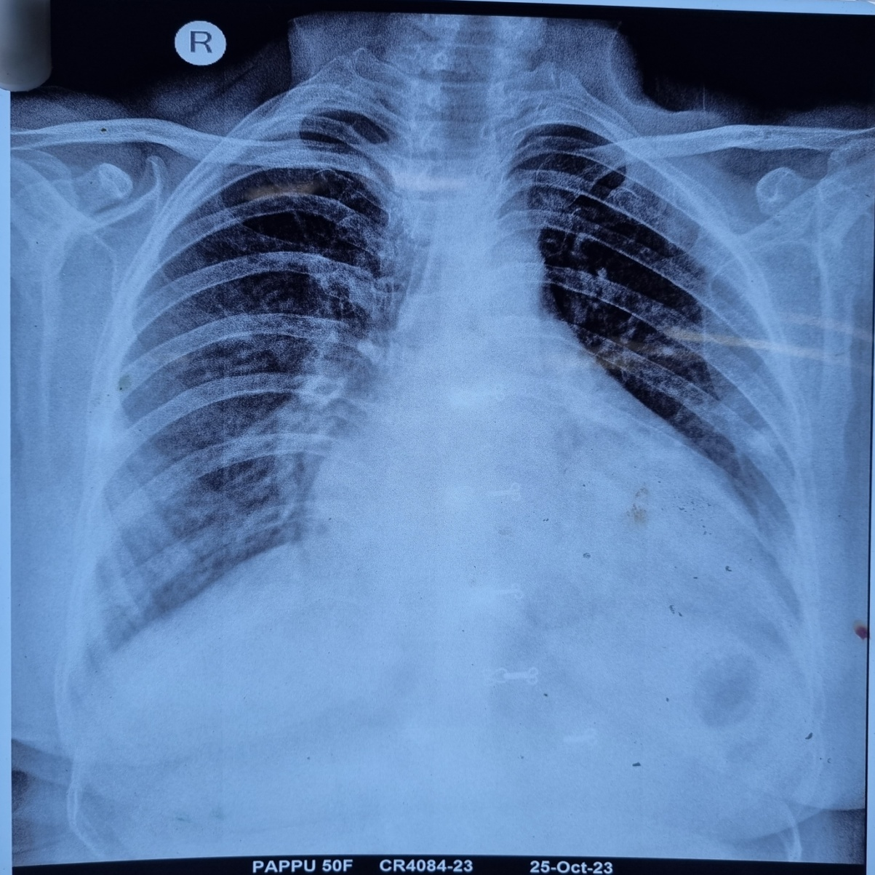
CHEST XRAY

Slide 21
ECHO
LV dilated
Global hypokinesia of LV
Aortic root dilated
Internal flap dissection seen in ascending aorta and arch of aorta
AR – moderate to severe
No pericardial effusion
EF – 43%
Imp: ASCENDING AORTA ANEURYSM
To do: CT Aortagram

Slide 22
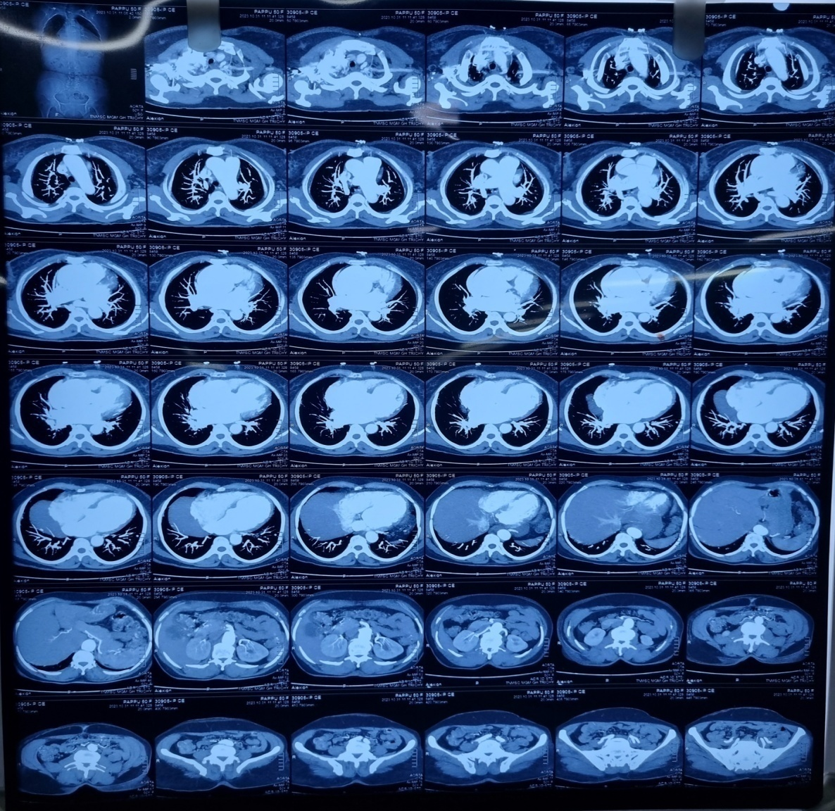
CT AORTAGRAM

Slide 23
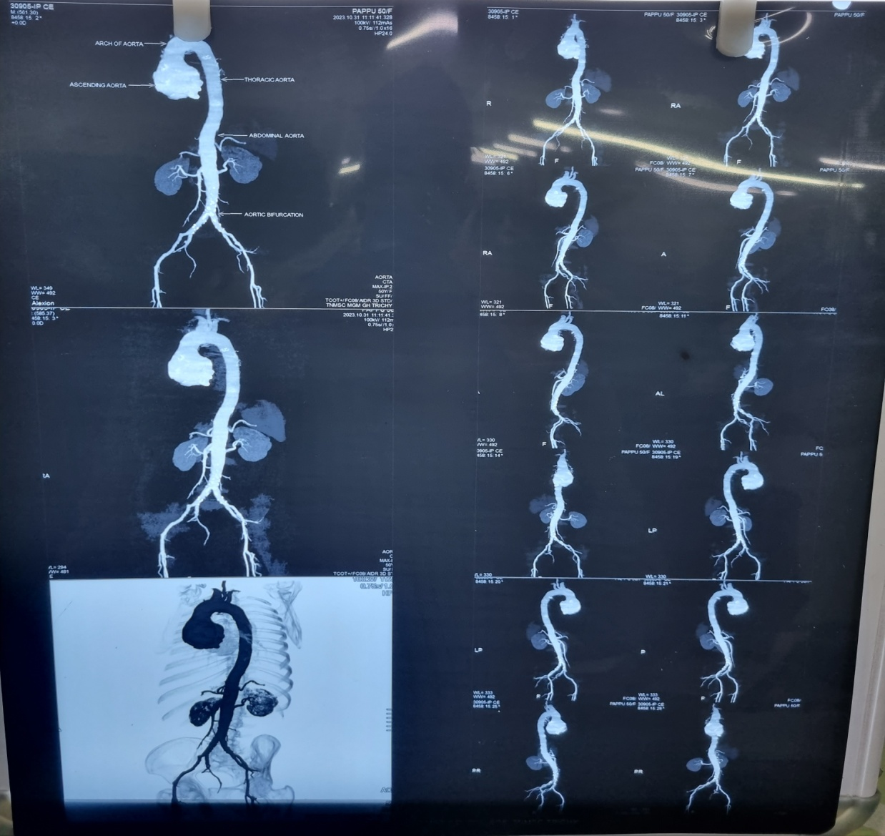

Slide 24
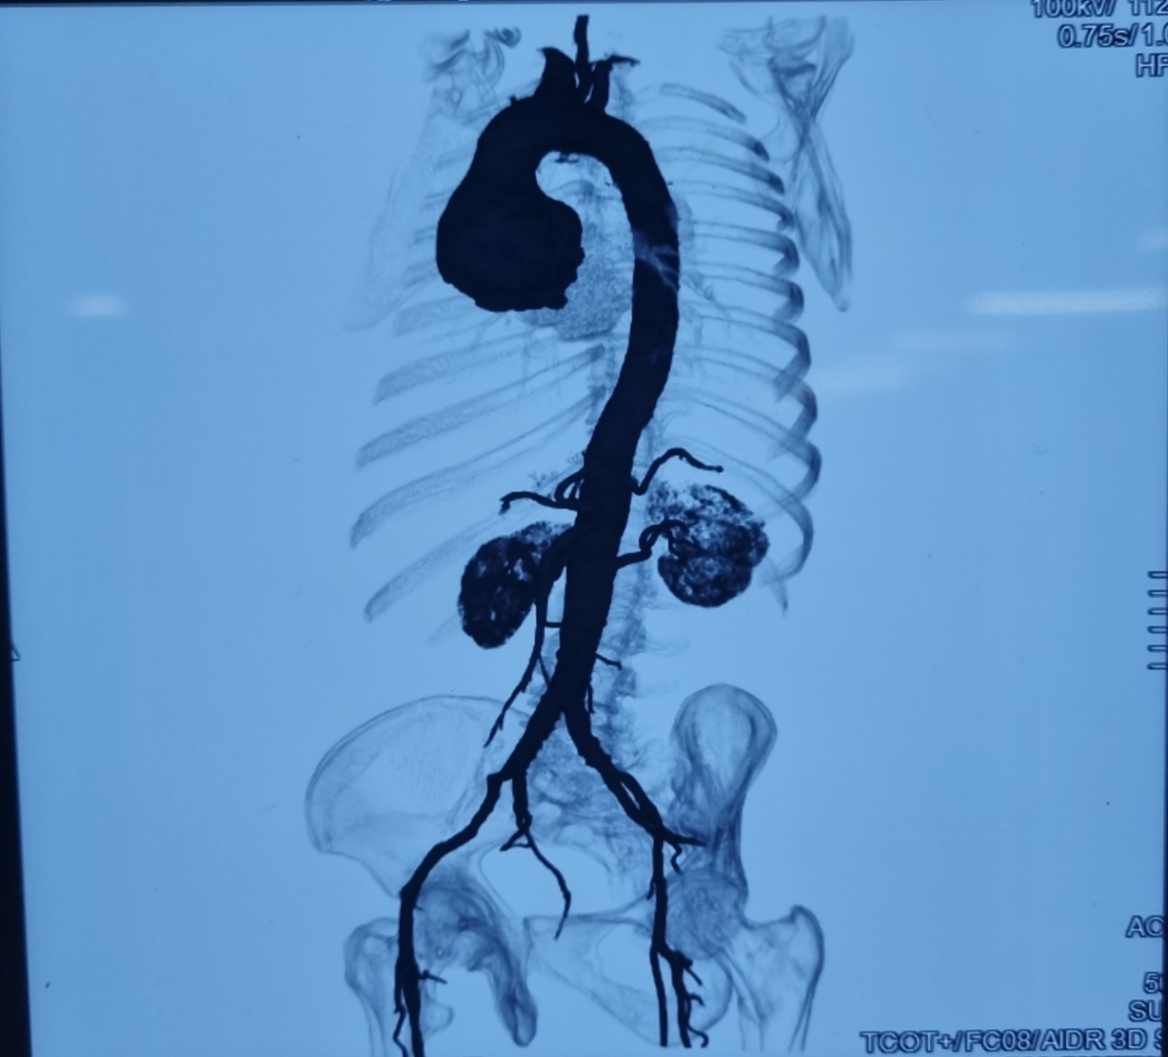

Slide 25
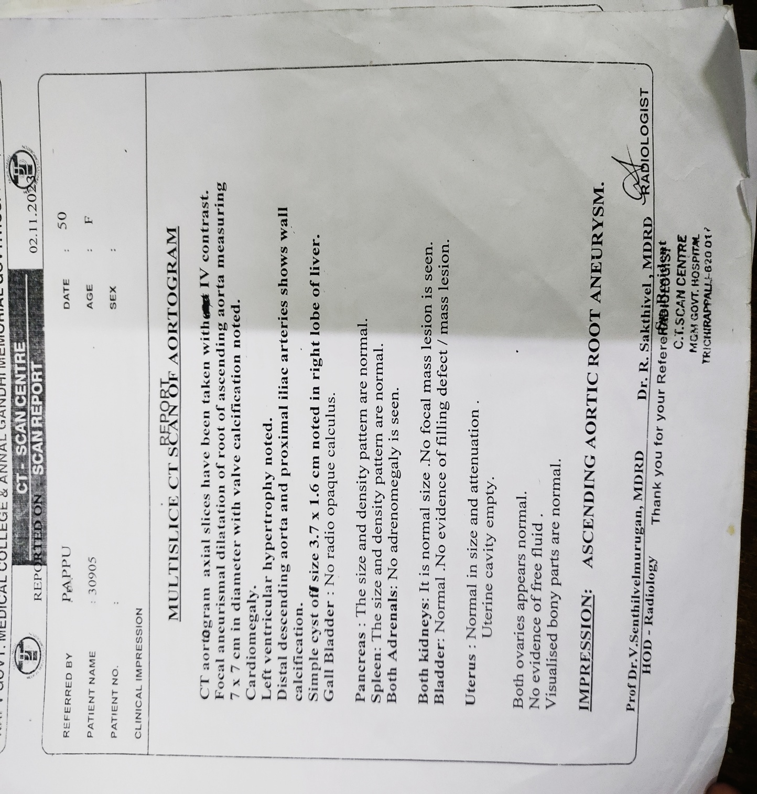

Slide 26
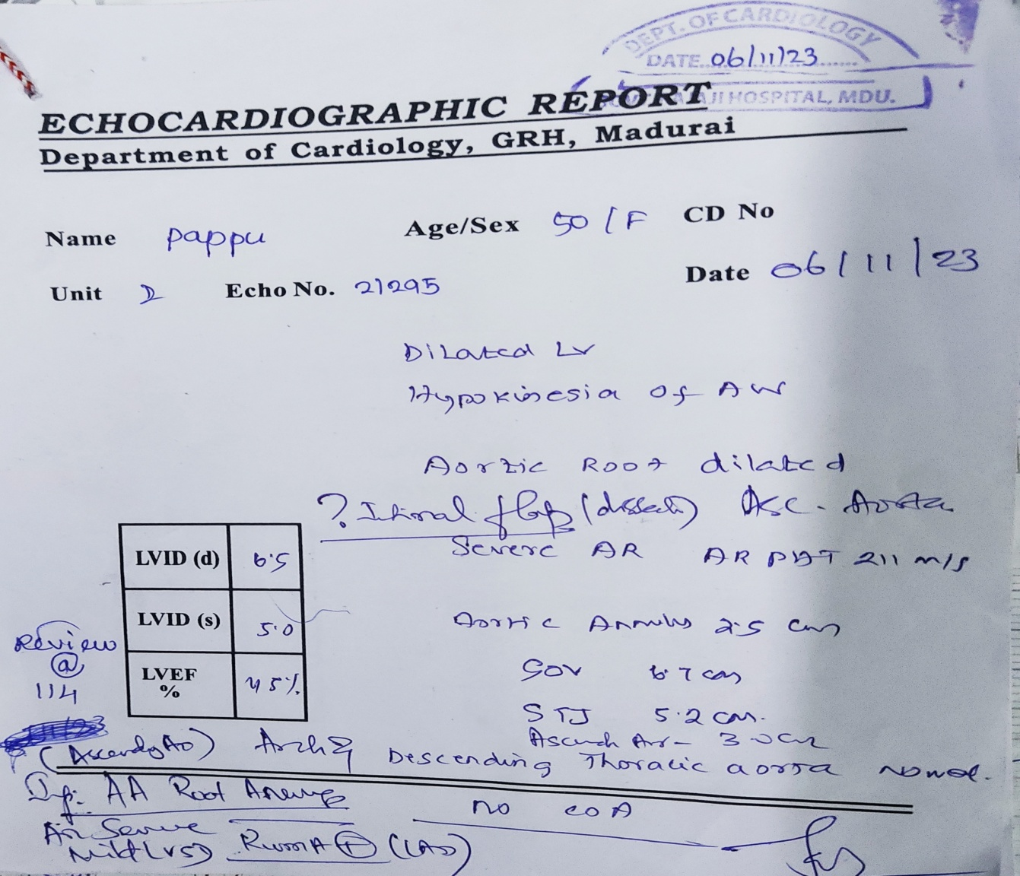
REVIEW ECHO

Slide 27
CRP – negative
ESR – 18 mm/hr
VCTC – non reactive
HbsAg / HCV – negative
ANA – positive
ASO titre – positive
RA Factor - negative

Slide 28
RPR – Non reactive
Sr. TPHA – Positive
CSF ANALYSIS:
TC – 2 cells / 10 HPF
DC – 2 Lymphocytes
Protein – 42
TPHA – Negative
VDRL – reports awaited

Slide 29
STD OPINION
RPR – Non reactive
Sr. TPHA – Positive
Diagnosis : Late latent syphilis / cardiovascular syphilis
Advice:
plan : lumbar puncture – CSF analysis
INJ. Benzathine penicillin 2.4 million units im , 3 doses 1dose/wk.

Slide 30
DERMATOLOGY OPINION
Genital examination:
external genitalia – normal
external urethral meatus – normal
no discharge at introitus
skin, mucosa, scalp, hair, oral cavity, palms, soles, nails – normal
Advice:
lumbar puncture
inj. Benzathine penicillin 3 doses 2.4 million units, as deep im, in each buttock , after test dose

Slide 31
NEUROMEDICINE OPINION
O/E
Conscious, oriented
PERL +, Full EOM
No meningeal signs
Tone – normal
Power – 5/5 in all 4 limbs
B/L plantar flexor
sensory – normal
cerebellum – normal
Advice:
continue same line of management

Slide 32
OPHTHALMOLOGY OPINION
Imp: BE) Normal fundus at present
GYNAECOLOGY OPINION
P/V –uterus anteverted
bilateral fornices free
no bleeding p/v , no discharge p/v
Advice:
continue same line of management

Slide 33
TREATMENT GIVEN
T. Frusemide 40 mg ½ OD
T. Thyroxine 100 mcg 1 OD
T. Atorvastatin 10 mg 2 HS
first dose of INJ. Benzathine Penicillin 2.4MU deep im given after dose

Slide 34
THANK YOU

