Slide 1
CPC BY MU3 CHIEF DR.K.SENTHIL MD ASSO PROF :DR.MURALIDHARAN MD ASST PROF:DR.MANIKANDAN MD DR.SARAVANA MADHAV MD DR.ILAMARAN MD DM

Slide 2
CHIEF COMPLAINTS
A 36 yr old female came to GRH with C/o easy fatigability,pain abdomen for the past 2 months

Slide 3
c/o easy fatigability for the past 2 months
c/o pain abdomen for 2 months ,lower abdominal pain , pain radiating to back , No aggravating or relieving factor
c/o back pain
no c/o excessive menstrual bleeding
no c/o passing loose stools
no c/o vomiting
no c/o abdominal distension
no c/o bleeding PR
no c/o loss of weight

Slide 4
no c/o loss of appetite
no c/o leg swelling
no c/o breathlessness
no c/o chest pain
no c/o joint pain
no c/o dysphagia
no c/o skin rashes
no c/o cough with expectorations

Slide 5
PAST HISTORY:
Not a k/c/o DM,SHTN,Thyroid disorders,CKD
no previous h/o blood transfusion
Previously treated for UTI and PID with antibiotics

Slide 6
MENSTRUAL HISTORY:
Attained menarche at 13 yrs
2/30 cycles
not a/w clots and pain
LMP 10/02/24
P1L1 LCB 14 Yrs back LSCS
PERSONAL HISTORY:
Consumes mixed diet
normal bowel and bladder habits

Slide 7
ON EXAMINATION
Afebrile
Pallor ++
no icterus
no cyanosis
no clubbing
no pedal edema
no lymphadenopathy
No knuckle hyperpigmentation

Slide 8
VITALS :BP -100/60 mm Hg in supine position recorded in right arm
PR-92/min
SPO2 -99% @RA
CVS -S1,S2 + ESM murmur over PA
RS- BAE+ NVBS
PA - Soft
non tender, no organomegaly
not distended
bowel sounds +
CNS - No focal neurological deficit

Slide 9
INVESTIGATIONS
28/03/2024
TLC -9600
RBC -1.24millions
HB -3.7
Hematocrit-12.3
MCV -99.2
MCHC -29.8
Platelet -44,000
RDW CV -28.7%
ESR -140 mm/hr
qCRP -118
Sr calcium – 9.3
Urea - 21
creat -1.3
Na -139
K - 3.9
T Bilirubin-2.5
D.Bilirubin-0.3
I.Bilirubin -2.2
SGOT -58
SGPT -32
ALP -660
Sr LDH -1992

Slide 10
T.Protein -5.6
Sr Albumin -3.4
Sr Globulin -2.2
ANA by ELISA –Negative
DCT – negative
Sr TSH -0.795 U/ml
HBsAG -Negative
HCV -Negative
VCTC - Non reactive
Sr Cholesterol -154
Sr TGL -215
Sr HDL -82

Slide 11
Peripheral Smear
Hypochromic microcytic anemia with Neutrophilic leucocytosis and thrombocytopenia
schistocytes,burr cells,target cells present
Retic count 4.5%

Slide 12
USG ABDOMEN & PELVIS(29/03/24)
LIVER - 11.6 cm ,Normal echoes
GB - GB wall edema noted
SPLEEN-9.5 cm,Normal echoes
RK- 8.5 * 5 cm LK -8.8 * 4.9 cm Normal echoes,CMD+
Mild Left PUJ dilatation with Ureteric dilatation +
UTERUS- 8.4 * 2.3 cm,Uteroparietal adhesion +
RIGHT OVARY-2.9*1.6 cm Left ovary not visualized
5.6*3 cm cyst with internal echoes noted in left adnexa
IMPRESSION: LEFT MILD HUN
LEFT HEMORRHAGIC CYST

Slide 13
BONE MARROW ASPIRATION SMEAR:
Leucoerythroblastic blood peripheral smear
Hypercellular marrow with myeloid : erythroid
ratio 2:1
Erythropoiesis , Leucopoiesis, Megakaryopoiesis are normal
IMPRESSION : REACTIVE MARROW

Slide 14
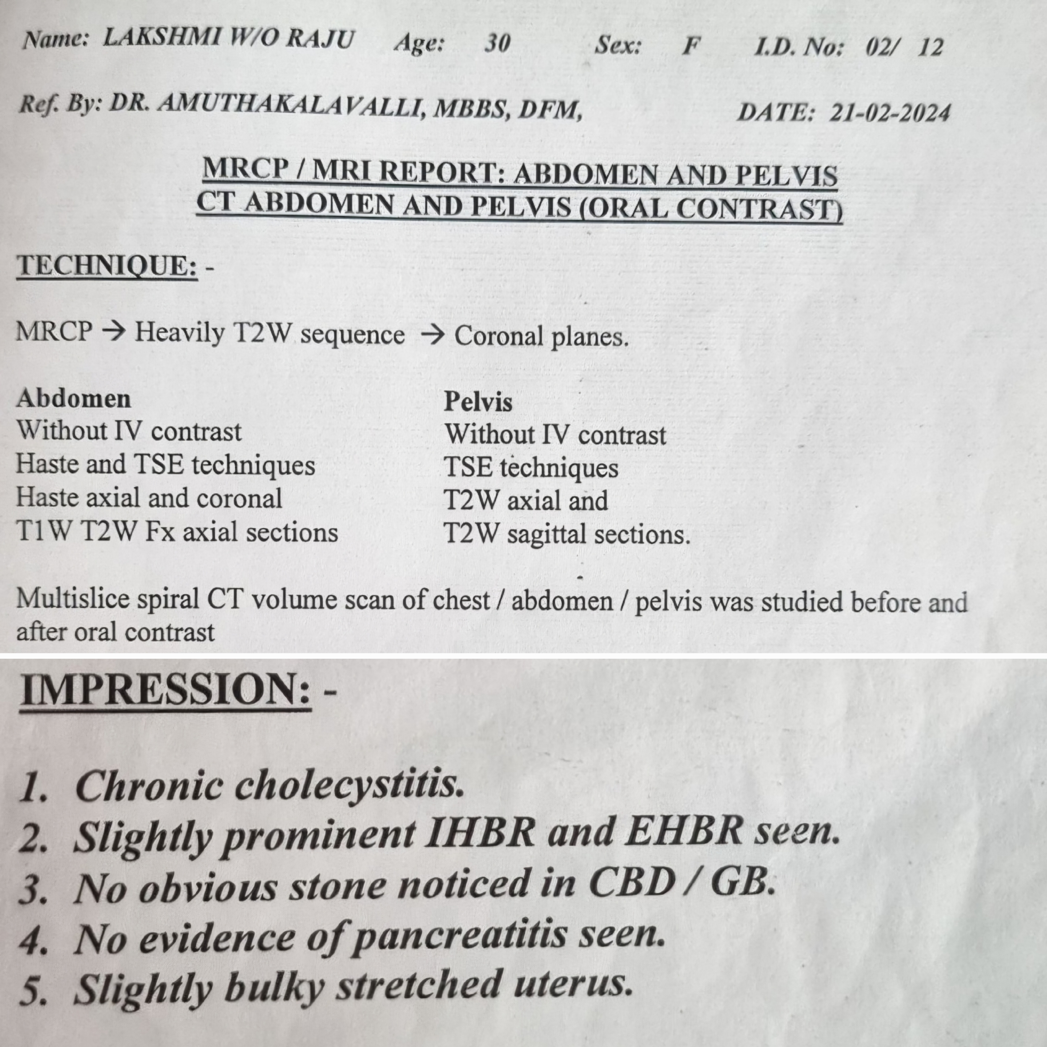

Slide 15
CT THORAX(06/04/24)
Bilateral mild pleural effusion
Multiple lytic lesions noted in vertebrae,sternum, humerus

