Slide 1
PHYSCON -2021
By Medicine unit 1
Unit chief: Dr Natarajan MD
Asst professors:
Dr.Shridharan MD
Dr.Vasanthakalyani MD
Dr.Suresh kumar MD

Slide 2
Presenting complaints
18 yr old male came with c/o
Easy fatigability for past 2 wks
fever for 4 days
breathlessness for 4 days
No h/o abdominal pain ,pain over hands/swelling of hands
No h/0 pedal edema,orthopnea and pnd
Past history:
H/o multiple blood transfusion + for hematological disorder
not a k/c/o t2DM ,S-HTN, BA, Epilepsy

Slide 3
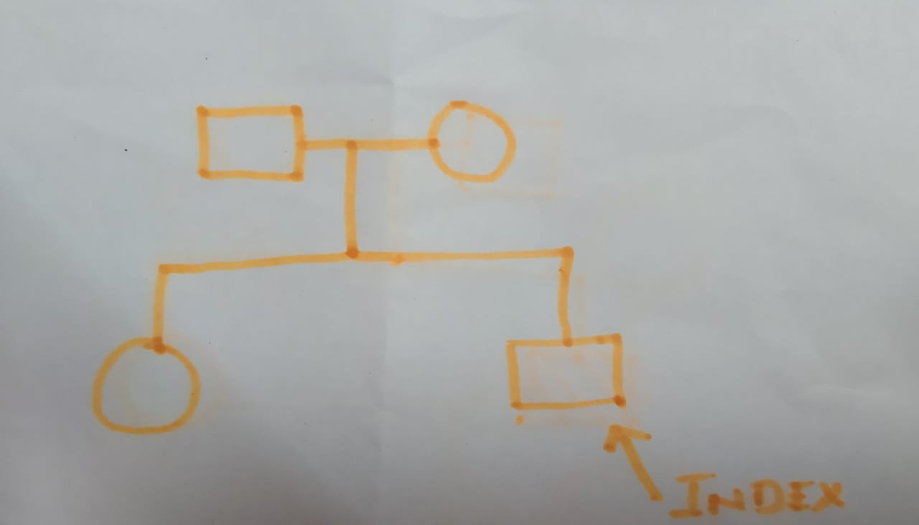
Family history

Slide 4
on examination
severe pallor + ,icterus+ (lemon yellow),no cyanosis ,no clubbing ,no generalised lymphadenopathy, sternal tenderness +
ill built ,prominent facial bone,no pedal edema, normal hair, no hyperpigmented Palmar crease
vitals
PR -140/min
BP- 100/60 mm hg
SPO2 - 97 % @room air

Slide 5
systemic examination
cvs : s1s2 + heamic murmur +,venous hum +
Rs :BAE+ , no added sounds
p/a : soft ,bs +,moderate spleenomegaly, liver 2cm below rt costal margin
CNS :NFND , moves all 4 limbs

Slide 6
investigation
date | 29/12 | 31/12 | 5/1/21
TC | 32000 | 13000 | 5100
DC | 52/41/7 | 31/58/ 11 | 25/50/ 25
HB | 3 | 5.3 | 7.7
PCV | 9 | 18 | 24
PLC | 1.68 LAKHS | 1.44 | 1.83 lakhs
ESR |  | 44 MM /HR
Total biliubin | 4.6 | 2.6
direct | 0.8 | 0.8
indirect | 3.8 | 1.8
SGOT | 712 | 36
SGPT | 269 | 84
ALP | 39 | 54
Urine bile pigments | Negative

Slide 7
Covid swab - negative
usg abdomen showed moderate splenomegaly,no free fluid in abdomen ,no gb wall edema.
serum ferritin : 307.50 [ref value -39.3 to 439.4]
urine routine : with in normal limit
Echo: ejection fraction 67% with mild TR +, no evidence of dilated ventricle
Typhidot negative
RDT - negative

Slide 8
CRP - positive
urine culture - negative
blood culture- bacillus non fermentable

Slide 9
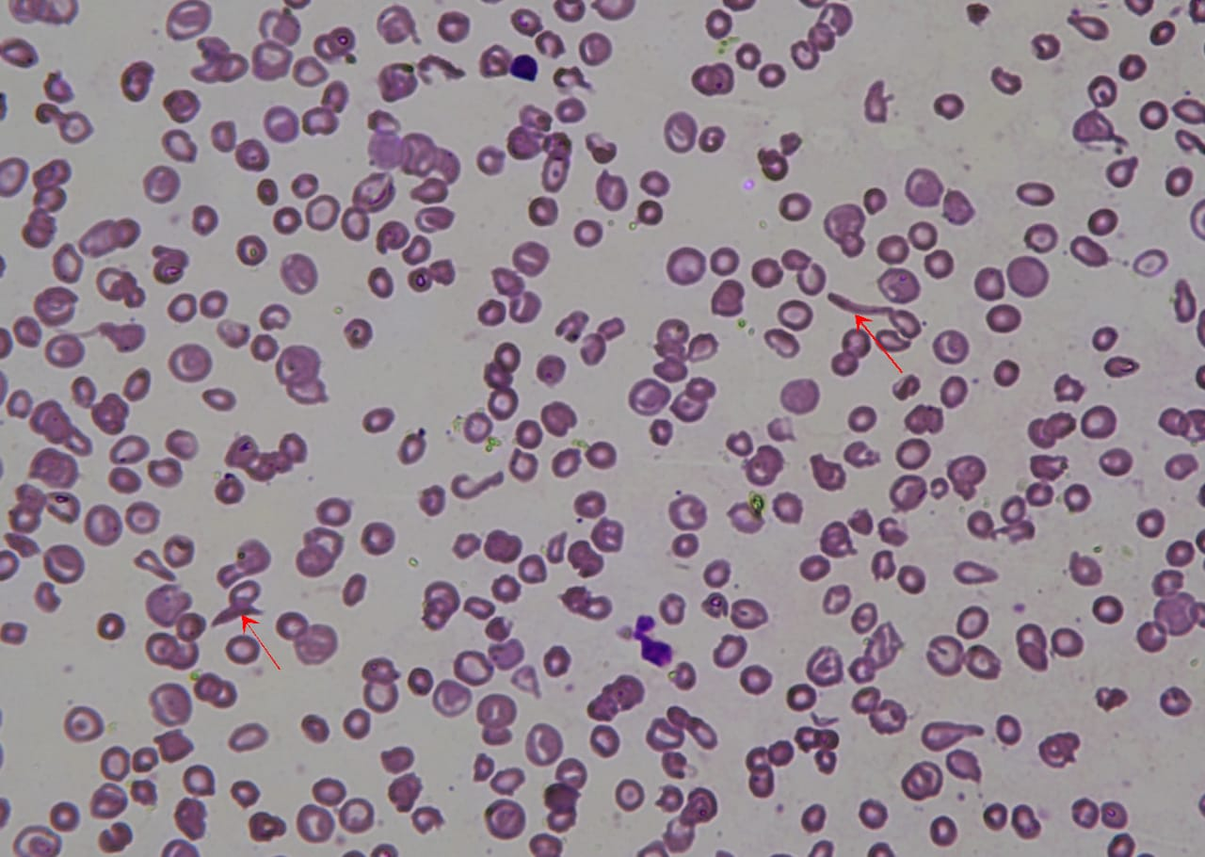
Peripheral smear report
sickle cell target cell microcyctic hypochromic
stomatocytes are seen

Slide 10
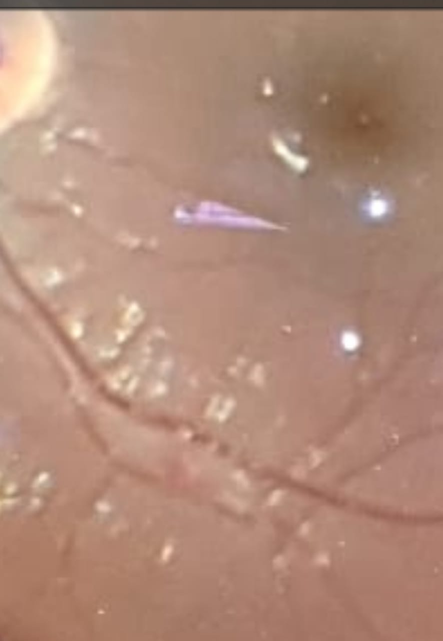
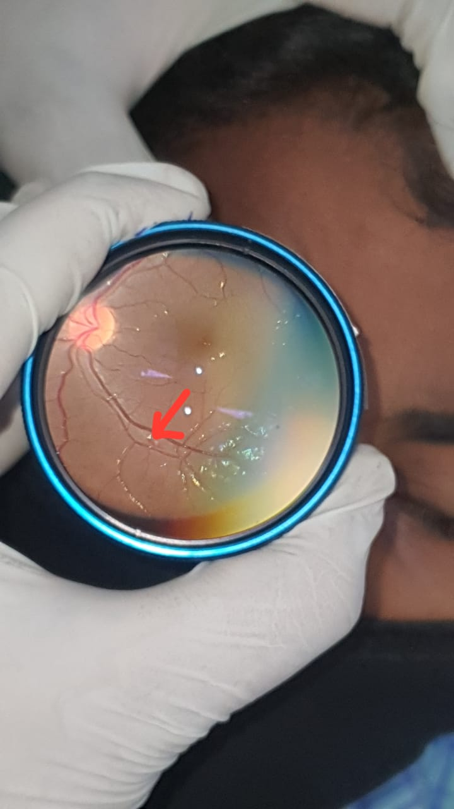
ophthal opinion
on 31/12/2020 ophthal opinion: superior temporal arcade hemorrhage on fundus examination
on 3/1/2021 fundus examination shows mild hemorrhage in resolving stage

Slide 11
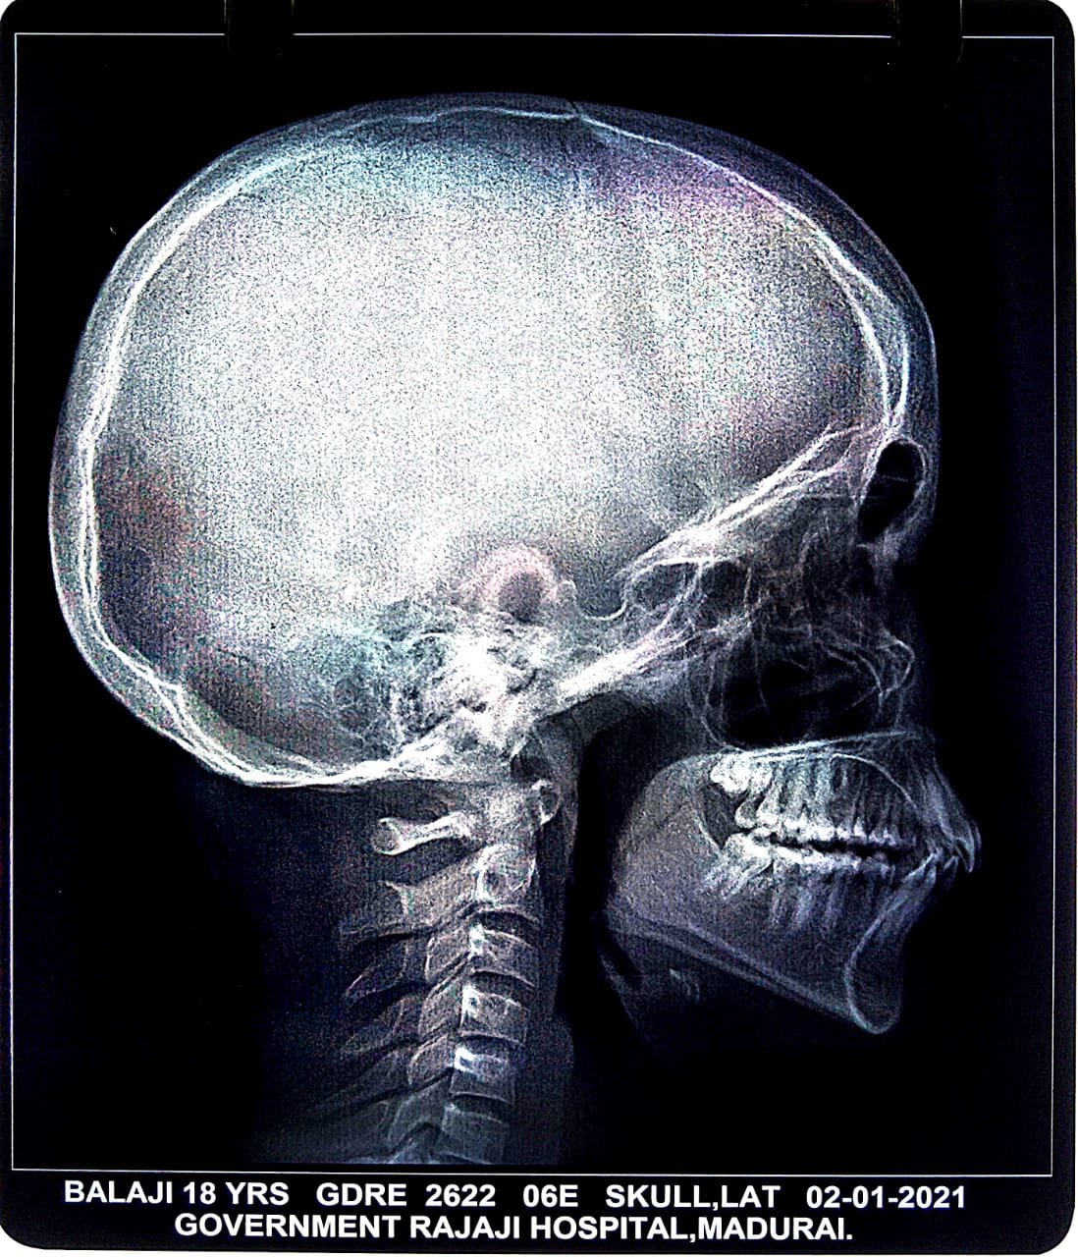
No evidence of crew cut appearance but diploic space expansion is present

Slide 12
Hb electrophoresis

Slide 13
Treatment
IV fluids
Antibiotics iv
Blood transfusion
Other supportive drugs
plenty of oral fluid

Slide 14
Sickle thalassemia

Slide 15
Aim of this presentation
Usually isolated sickle cell anemia have autosplenectomy at the age of 18 yrs but coexisting thalassemia is preventing it
Usually isolated sickle cell anemia have multiple episodes of crisis but this boy doesnot have any such crises this is also bcoz of thalassemia
Whenever known hemoglobinopathy patient present with less number of crisis and less severe disease we have to think about hb heterogeneity

Slide 16
Thank u all

